Slide 1




Slide 2
Index
Introduction
Statistics of Flip-it course in Spain
Best practices
Quotes
Conclusions

Slide 3

Introduction

Slide 4
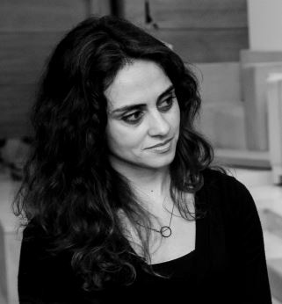
Pedagogue
Teacher and researcher at Universidad Europea (Madrid.Spain)
Specialist in teacher training for early childhood, primary, secondary and VET education.
Advisor of schools in technology and educational innovation.
@soniamrequejo @ueuropea

Slide 5

Statistics
More details about the course

Slide 6
Participants
67 participants

Slide 7
FC Planning and practice
Students who delivered the activity about carrying out an FC session in the classroom VS those who did not
Most of the teachers did not have enough time to plan and carry out a FC session this course

Slide 8
Most popular tools used

Slide 9
Details of activities´s context

Slide 10

Best practices
Of participants

Slide 11

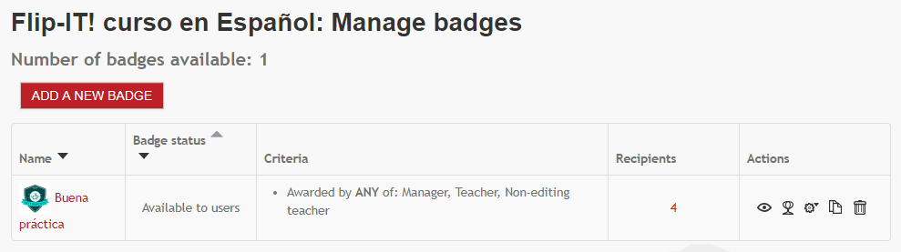
Gamificate-It
Badges to identify the best practices in the Flip-it course

Slide 12
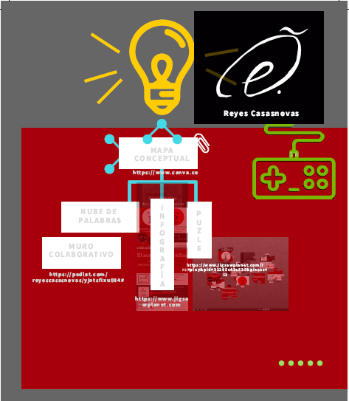
Lesson map
Integrate variety of technological resources to share the contents
Institution: Universidad de Zaragoza
Department of Spanish as a Foreign Language
Lesson topic: Pronunciation and accents in Spanish
Practice: Next schoolar year
https://reyescasasnovas.wixsite.com/onlinespanish/pronunciacion

Slide 13
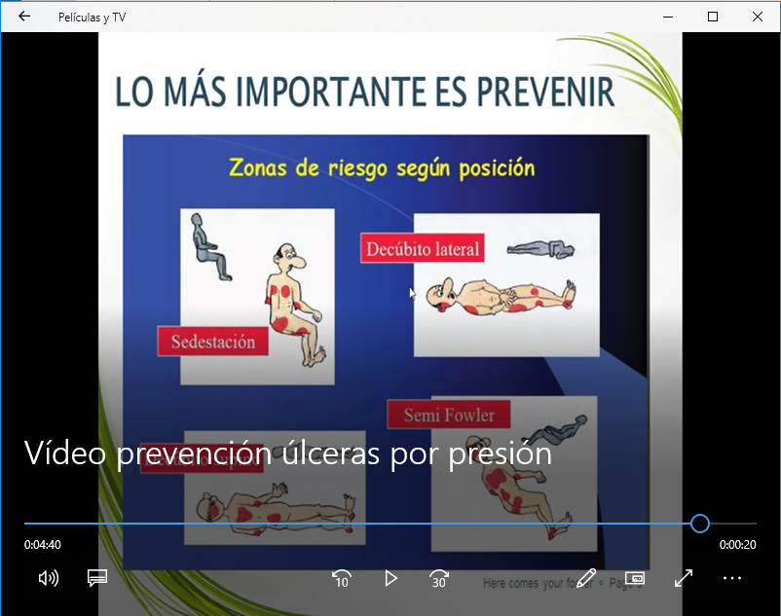
Promotion of collaborative work in the classroom
Institution: Grupo Aula Formación y Emergencias.
VE. Nursing assistant
Lesson topic: pressure ulcers
Practice: May 2018
In groups, they prepare a treatment with a patient and expose this treatment to the rest of their classmates.

Slide 14
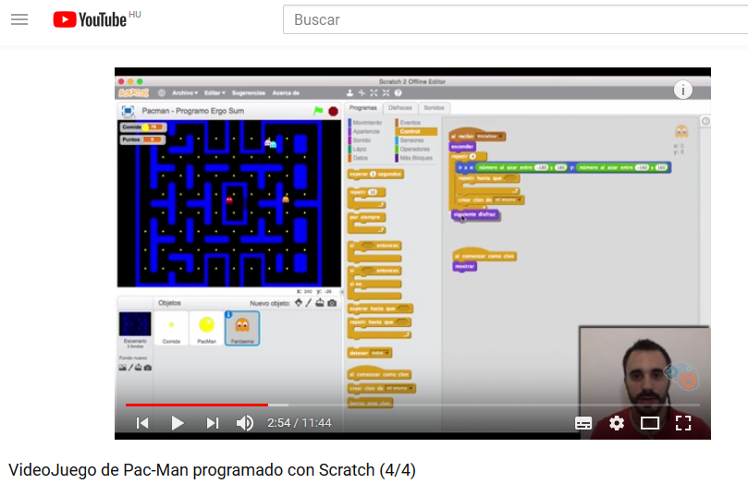
Promotion of meaningful and functional learning
Institution: Universidad Europea
VE. 3D Animation, Games and Interactive Environments
Lesson topic: Multimedia projects
Practice: May 2018
In class they must develop a Pacman game following the instructions of the videos they saw at home while the teacher asks questions questioning the process as "what would happen if I omit this order and put this one?”.

Slide 15
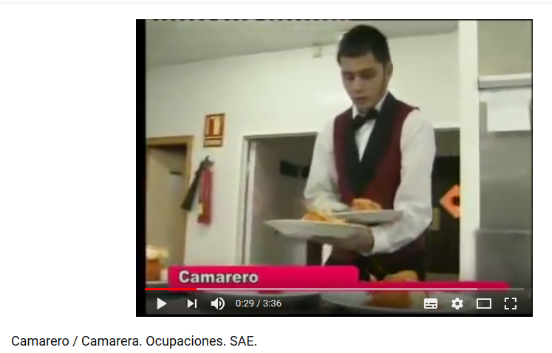
Video that defines the job according to the regional employment agency
Promotion of meaningful , functional and collaborative learning
Institution: Fundación DYA Navarra
VET
Lesson topic: Educational Methodology. Programing VET course
Practice: May 2018
In groups, they analyze the job position presented in the materials seen at home and design a course for their professional training.
Each group exhibits its planning.

Slide 16

quotes
From participants throughout the course

Slide 17
"From the pedagogical point of view it has been a very good experience for the users since it has allowed them to bring the contents prepared from home and so that the programs have been more agile and able to dedicate more time to the practice and resolution of problems, from the methodological point of view allows us a better planning of the contents of the class, adapting those contents to the participants of the program and carrying out a continuous evaluation ".
"The benefits that I see in my usual center and in this as something new is that they feel more participative, they are the ones who look for and read information to finish the activity and complete it with my help."
"As a teacher it is a more collaborative learning where everyone contributes to the contents, and less expensive as a teacher in the transmission of concepts for student learning."
"The proposal to work at home the material, dislocates the students, takes them out of what they have lived so far as a teaching-learning process."
“The student is the protagonist and guides his process."

Slide 18

conclusions
Flip-it course

Slide 19

About flipped learning methodology
The active participants value the effectiveness of the flipped learning methodology
Participants highlight the potential of the methodology for students to be protagonist of their learning
The methodology requires more time to prepare (material and planning activities)
Technology is necessary to apply the methodology

Slide 20


