Slide 1
Flipped Clasroom Practice in the Czech Republic
Martina Maněnová
Věra Tauchmanová

Slide 2
Results of questionnaire - Description
10 % from CZ (54)
Age – 63 % from 36 to 54
Gender – 56 % male, 44 % female
Teaching experience: 69 % 0-15 years
50 % BSc/Bc (practice stressed)
44 % technical engineering, 13 % social science
57 % of schools: 201-500 students; 21-100 teachers

Slide 3
Results of questionnaire - Description

Slide 4
Pedagogical methods

Slide 5
Views of FC

Slide 6
Views of FC

Slide 7
Aspects of change class work

Slide 8
Impressions of FC

Slide 9
Important competences

Slide 10
IT skills

Slide 11
Work with media

Slide 12
IT tools/features

Slide 13
IT tools/features in class

Slide 14
Tools for students

Slide 15
Results
The Flipped Classroom is a new method for Czech teachers.
The most frequently used IT tools at Czech schools are PC (+ the Internet access) and presentation tools.
Differences between HU, ES and CZ can be seen.

Slide 16
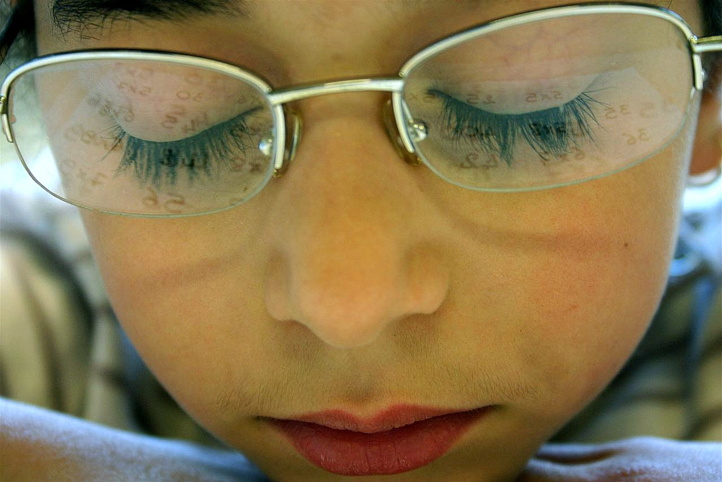
Thank you for your attention.

