Slide 1
FlipIT!
UEM Madrid Meeting
June 2016
Madrid
Shane Cronin and Darragh Coakley

Slide 2
Flipped Learning Model at CIT
Online Masters in E-Learning Design and Development

Slide 3
About the course
Delivered completely online
Number of lecturers
Moving away from high stakes summative exams to continuous assessment
Heavy reliance on VLE and online collaborative tools

Slide 4
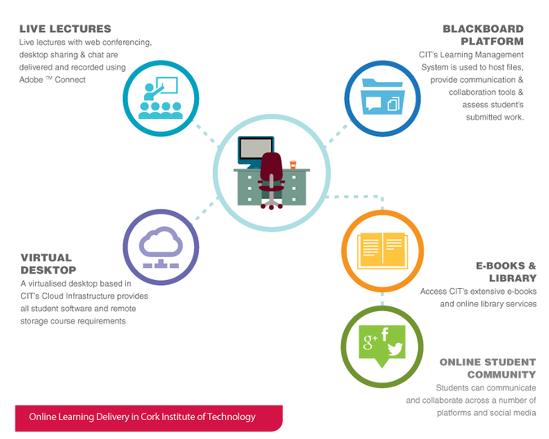

Slide 5
The Modules
Narrative and Games for Learning
E-Learning Authoring

Slide 6
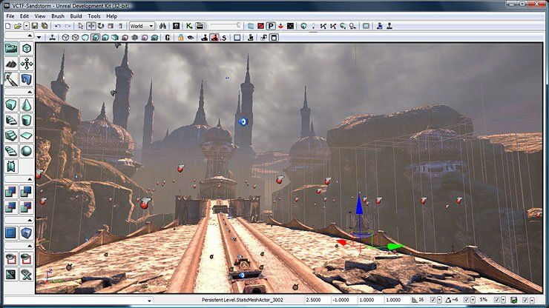
Our case study
Narrative and Games for Learning
Developing an Educational Game using Unreal Development Kit (UDK)

Slide 7
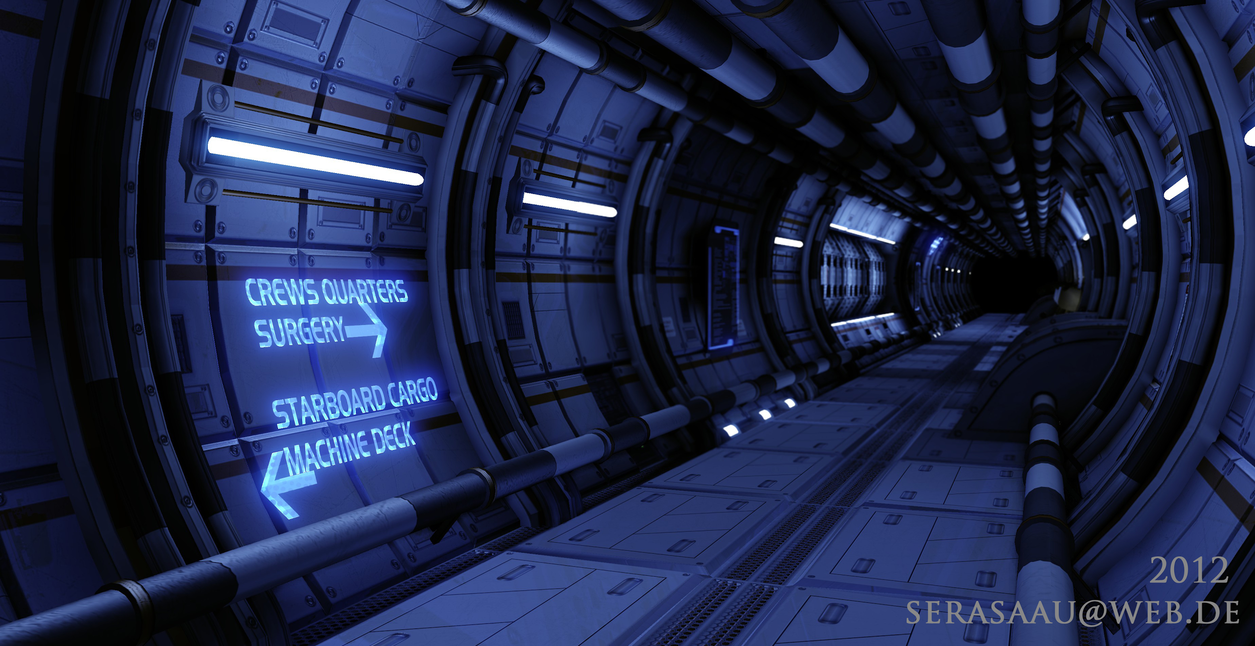

Slide 8
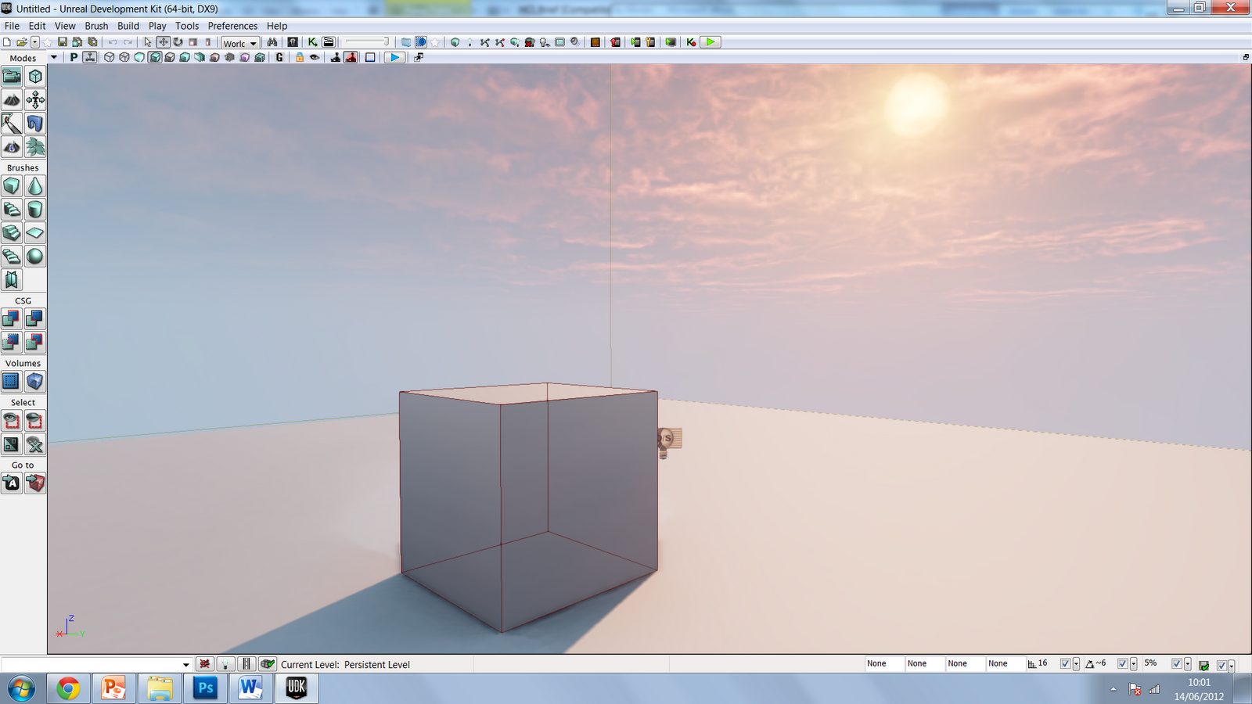
The Challenge
How to train online students in using a relatively complex piece of software?

Slide 9
The Challenge
Unreal Development Kit has a significant learning curve and so using live online classes to run through the software in a traditional mode was not suitable.

Slide 10
The Solution - an online Flip
Instructional videos for “out of class” viewing.
This left the instructor to use the live classes to discuss the software application with students and use this time as more of a workshop rather than wasting valuable time doing larger software tutorials.
Possible for instructor to demonstrate corrections, methods publically, instead of individually over email

Slide 11
The Solution - broken down
Developed a series of bespoke screencasts
Access a YouTube playlist with over 40 instructional videos/screencasts
Students carry out micro-learning activities, building on practical tasks through the course of the module
Assessment was to “put these together” - to build a game using all of the practical tasks done during the module

Slide 12
What we learned….
Tracking and monitoring students was important
In the live sessions, creating an open atmosphere where people would show their problems was important
Measuring student engagement
Traffic light system

Slide 13
What we learned….
“What do I do if my students show up to class and have not viewed the assigned content?”
Flipped classrooms are participative as opposed to prescriptive, so “picking” on people does not serve a purpose - the key is to engage & empower students as much as possible
Getting students to do activities (individual or group) if they do not have questions or work ready is a useful method
Students may also use time to prepare for or work on summative assessment

Slide 14
What we learned….
Moderation and scaffolding - don’t assume students will follow the course content from the beginning - they need guidance and orientation
Time should be considered for both students and teachers to look at pre-class material, to learn how to use systems, etc.

Slide 15
What we learned….
lectures and other activities were augmented by group chats and other means of facilitating collaboration and peer instruction
Google Community
Now we also have Google Spaces

Slide 16
Some tools to facilitate FC
Communication tools
Collaboration tools
Live e-learning tools
Asynchronous e-learning tools
Video services

Slide 17
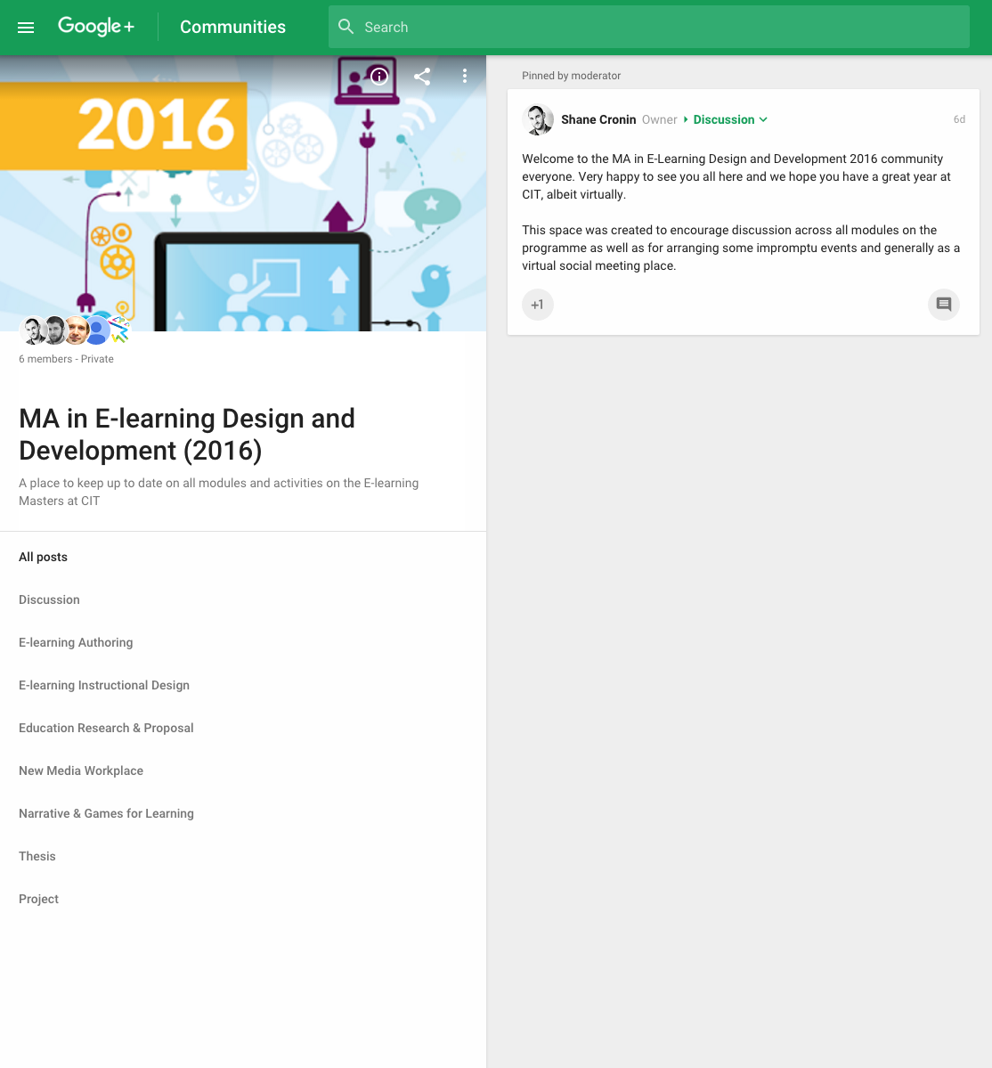
Google Community
Only @mycit.ie addresses permitted
Step by step tutorial at: http://ior.ad/4Ll

Slide 18
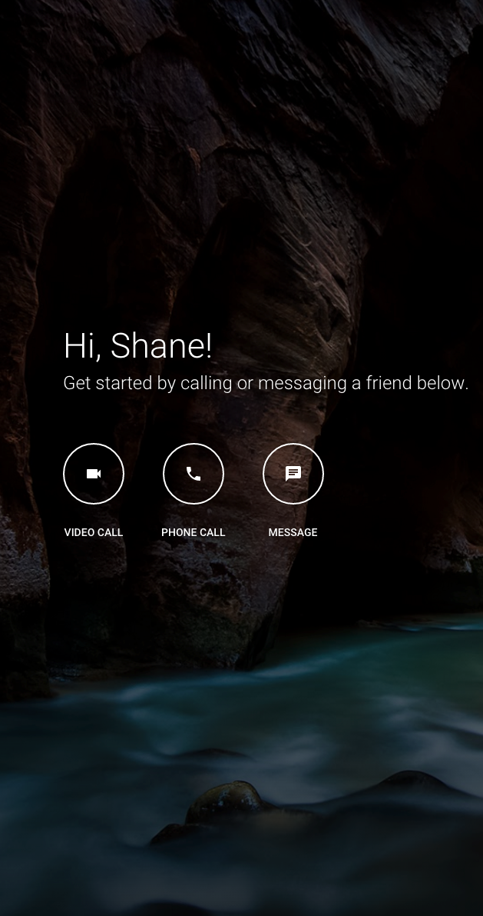
Google Hangouts
…… for impromptu group discussion:
https://hangouts.google.com/

Slide 19
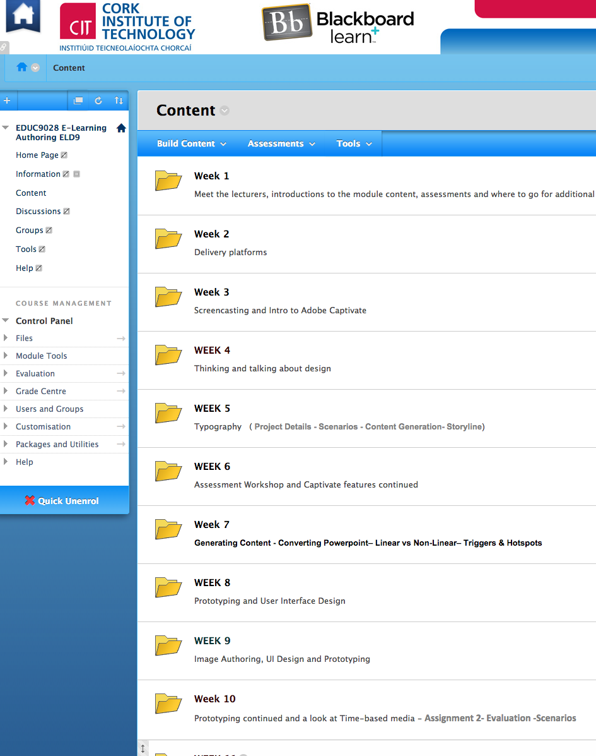
Blackboard
A space for lecture recordings, learning materials, assignments and course updates

Slide 20
What we learned….
Most faculty have limited knowledge of how to plan for and create an active learning experience within and beyond the classroom.
Strong need for training where pedagogy meets technology
They need this to be “workshopped” and guided through this process

Slide 21
What we learned….
Students value continuous assessment but need a clear schedule of assessments, weightings and criteria
To this end, assessment rubrics were provided - provided greater transparency, saved the lecturer time
More on this tomorrow on Assessment and Course Design

Slide 22
Other courses using Blends/Flips
Mathematics
Engineering
Media Communications
Strength & conditioning

Slide 23
Questions?

Slide 24
Flipped Classroom for VET
Brainstorming the special needs of VET

Slide 25
T Buzan, The ultimate book of mind maps:
“The easiest way to put information into your brain and to take information out of your brain – it’s a creative and effective means of note-taking that literally ‘maps out’ your thoughts.”
“You can compare a Mind map to a map of a city. The centre of your Mind Map is like the centre of the city. It represents the main thoughts in your thinking process; the secondary roads represent your secondary thoughts, and so on. Special images or shapes can represent sites of interest or particularly interesting ideas.”

Slide 26
M Michelko, Cracking Creativity - Benefits of Mindmaps
Activities your whole brain
Clears mind of mental clutter
Allows you to focus on the subject
Helps demonstrate connections between isolated pieces of information
Gives a clear picture of both the details and the big picture
Allows you to group and regroup concepts, encouraging comparisons between them
Requires you to concentrate on your subject, which helps get the information about it transferred from your short-term memory to your long-term memory

Slide 27
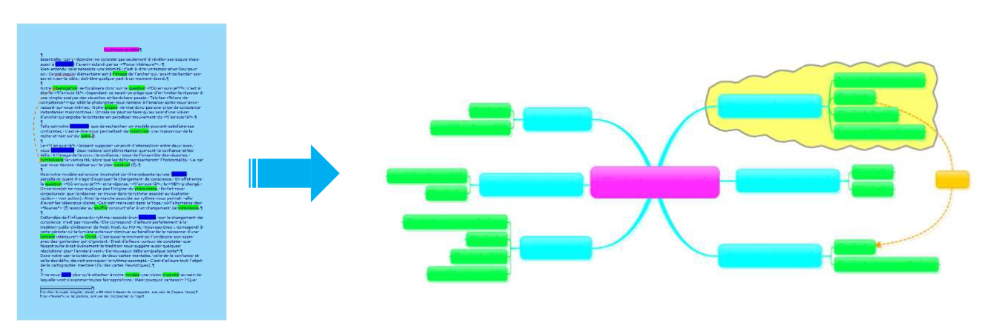
A large amount of information in many heads can be hard to get down on paper and hard to analyze once it is.
It can be hard to develop and maintain an overview of what this information is and how it is or should be structured.
It can be a challenge to reconstitute, resituate etc.
Putting things in a mindmapping format means moving from a linear to a radial information structure, where all useful data is included in a single diagram, can make it easier to maintain an overview.

Slide 28
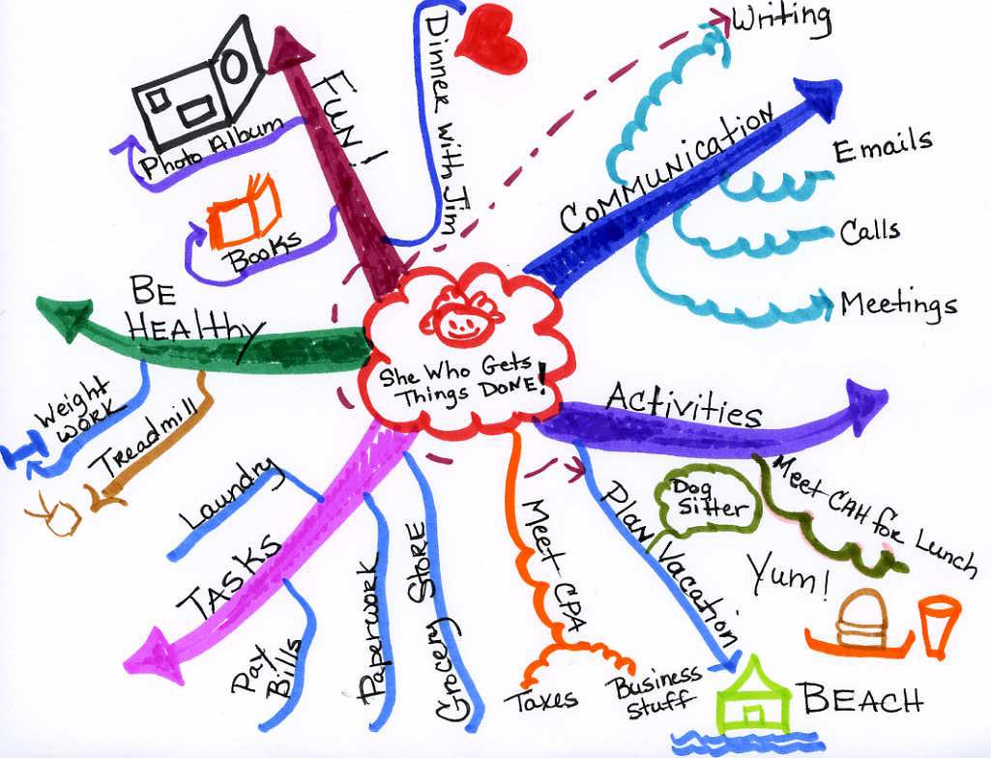

Slide 29
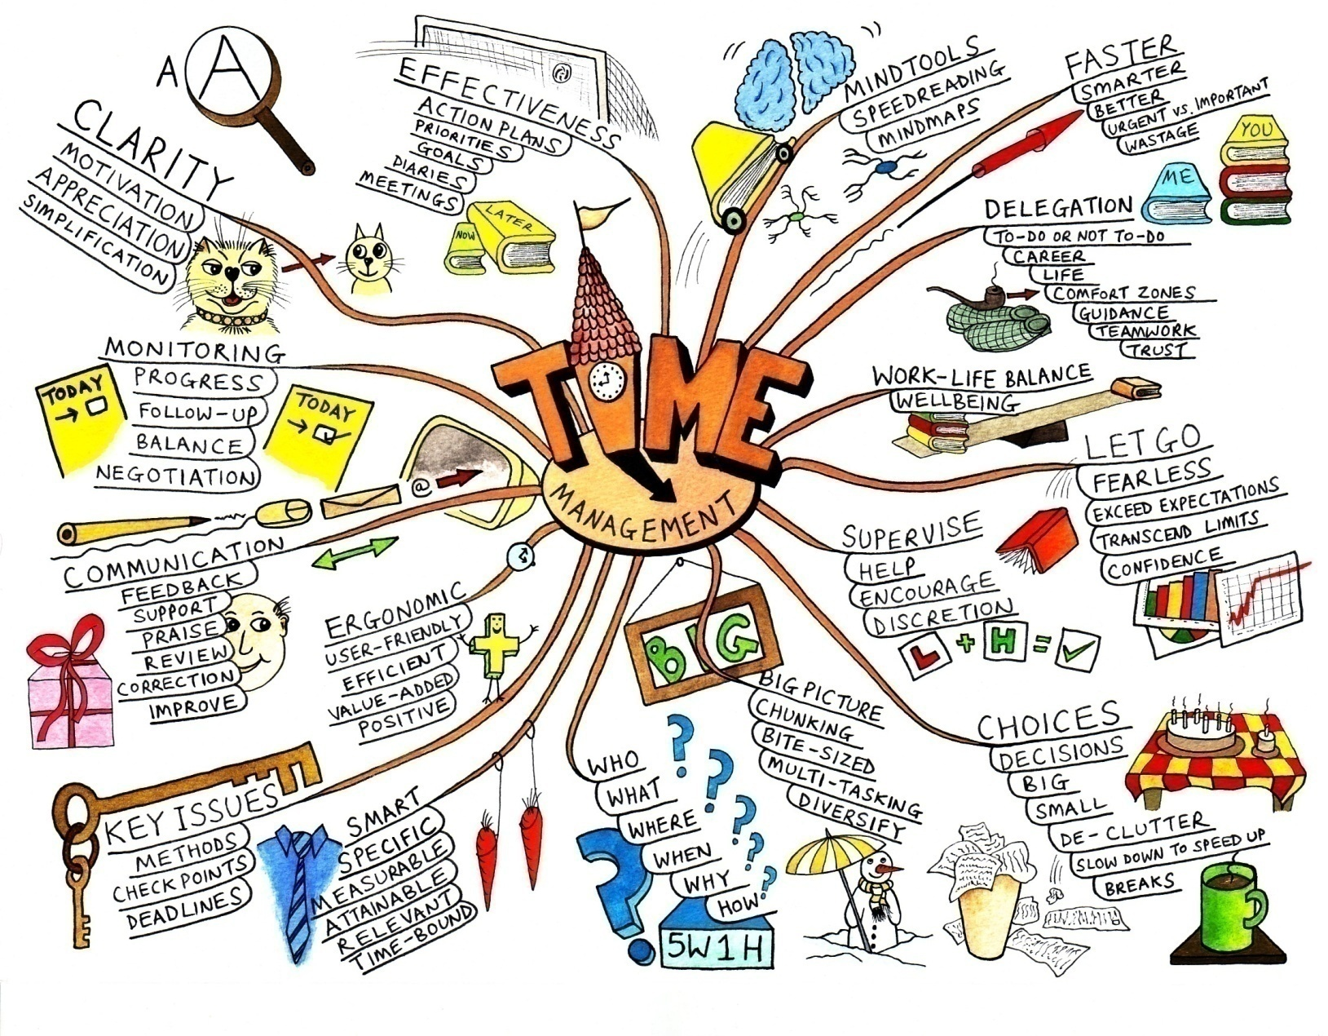

Slide 31
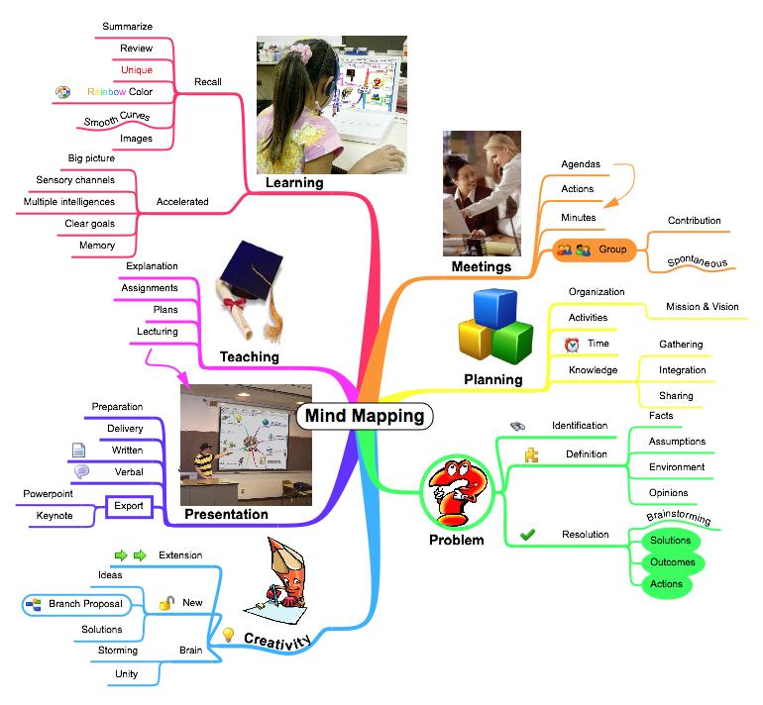

Slide 32
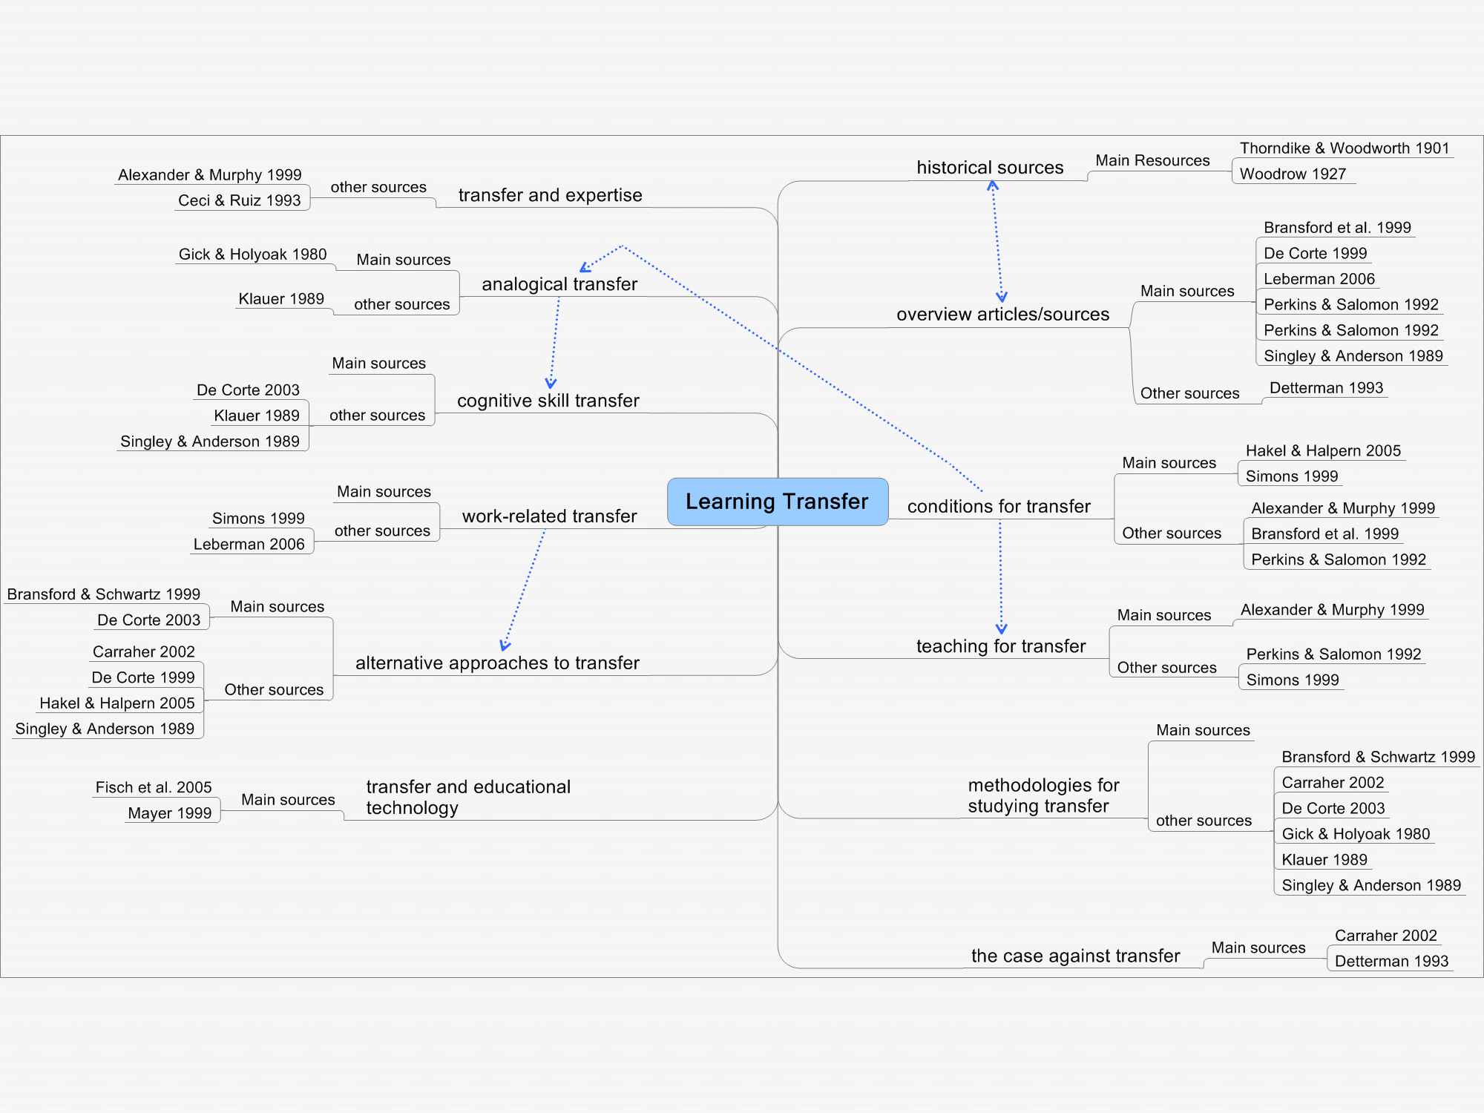
Mindmap which includes lots of citations, created using MindManager Software

Slide 33
An initial Brainstorming Activity
All Partners

Slide 34
An initial activity - for everyone to do
Take a blank sheet of paper. Turn it sideways (i.e. landscape orientation)
Start in the centre, using an image for your central idea
Connect some main branches to the central image and create new bubbles off these
Draw more branches from your new bubbles and so on
Try to use just one keyword per bubble
Draw some images if you would like
Any ideas / keywords you don’t know where to put, put them outside the map (top or bottom of the page)

Slide 35
And your topic is…
“E-learning/ Teaching with Technology”
You have 1 minute!

Slide 36
How did you do?
Number of links = creativity?
How many bubbles/concepts/keywords did your mindmap have?
How many images did your mindmap have?

Slide 37
Pick someone who did the same mind map and create a new and improved mindmap together
You have 3 minutes!

Slide 38
Brainstorm for the Potential of FC methods in VET
All Partners

Slide 39
Potential of FC methods in VET Mind Mapping
Use “FC methods for VET” in the center as the main theme.
Thinking about this, put down related key words and terms which come to mind (1 word per line if possible) and connect these to the main element in the center

Slide 40
Potential of FC methods in VET Mind Mapping
After this, add sub-branches carrying ideas using “sub- keywords" (again, use one word per line if possible).
Don’t limit to thinking in narrow terms - Draw quickly without pausing, judging or editing
Think of this as disposable
Notes:
Disposable

Slide 41
Potential of FC methods in VET Mind Mapping
This is not meant to be perfect, it is meant to be an initial attempt.
The point is to look at what each of us does and discuss it afterwards to identify important common elements.
We will present and discuss today.
After today, the mind maps will be made available online where work on them can continue

Slide 42
Keywords/ Questions - Think about:
What FC methods apply to:
Students online?
Teachers online?
Students in the classroom?
Teachers in the classroom?
What additional skills should FC be building in:
VET Teachers (as students)?
VET Students?
What about motivating:
VET Teachers (as students)?
VET Students?
What are the challenges in time/ budget/ IT?
What special needs does the VET sector have?
What are the FC methods that can support these special needs?
What are some relevant:
Pedagogical approaches?
Technological approaches?
Evaluation approaches?
Is this specifically for:
Secondary?
3rd level?
What to do when people do not watch material?
How to use FC for supporting practical learning?

Slide 43
Online Learning Content for Flipped Classroom
Work package Overview by CIT

Slide 44
The Flipped Classroom Model & VET
Notes:
So just very briefly, I’d like to cover an overview of screencasting

Slide 45
Some Background

Slide 47
Notes:
The Communiqué defines common objectives for 2020 and an action plan for the coming years, combining national measures with European support. This brochure introduces the context for this cooperation, the challenges to be met and the goals for the coming years.

Slide 48
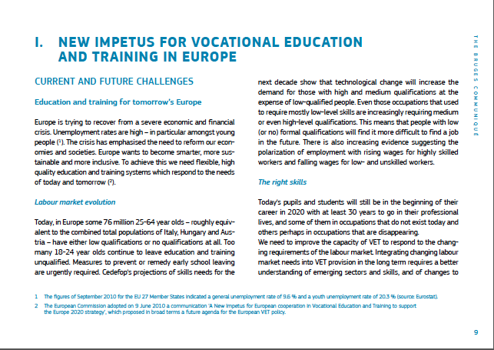
CURRENT AND FUTURE CHALLENGES FOR VET
Labour market evolution
The right skills
Ageing society
The dual objective of VET
Quality and excellence
Empowering people
Internationalising VET

Slide 49
Highlights
Right skills: “We need to improve the capacity of VET to respond to the changing requirements of the labour market. Integrating changing labour market needs into VET provision in the long term…we must regularly review occupational and education/training standards which define what is to be expected from the holder of a certificate or diploma.”
Empowering people: “This means enabling people to acquire knowledge, skills and competences that are not purely occupational…VET has to give learners a chance to catch up, complement and build on key competences without neglecting occupational skills. ICT skills and competences and foreign language skills, in particular, will become more and more critical in terms of getting and keeping a job and in managing everyday life”

Slide 50
Highlights
Ageing society: “adults – and in particular, older workers – will increasingly be called upon to update and broaden their skills and competences through continuing VET. This increased need for lifelong learning means we should have more flexible modes of delivery, tailored training offers and well-established systems of validation”
Quality and excellence: “transparency and a common approach to quality assurance are necessary to build up mutual trust which will facilitate mobility and recognition of skills and competences between those systems. In the decade ahead we must give high priority to quality assurance in our European cooperation in VET.”

Slide 51
Strategic Objectives & Short-term Deliverables
Making I-VET an attractive learning option
Fostering the excellence, quality and relevance of both I-VET and C-VET
Quality assurance
Quality of teachers, trainers and other VET professionals
Labour market relevance

Slide 52
Highlights
“Encourage practical activities and the provision of high-quality information and guidance which enable young pupils in compulsory education, and their parents, to become acquainted with different vocational trades and career possibilities.”
“Participating countries should improve initial and continuing training for teachers, trainers, mentors and counsellors by offering flexible training provision and investment.“
“VET curricula should be outcome-oriented and more responsive to labour market needs. Cooperation models with companies or professional branch organisations should address this issue and provide VET institutions with feedback…”

Slide 53
Highlights
“Work-based learning carried out in partnership with businesses and non-profit organisations should become a feature of all initial VET courses”
“Participating countries should support the development of apprenticeship-type training and raise awareness of this”

Slide 54
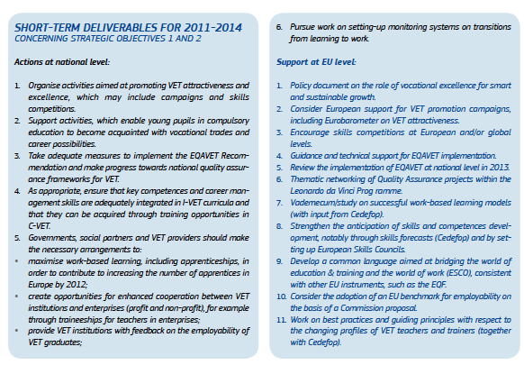

Slide 55
Other Highlights
Participating countries should actively encourage VET providers to collaborate with innovative enterprises, design centres, the cultural sector and higher education institutions in forming ‘knowledge partnerships’. This should help them gain valuable insight into new developments and competence needs
ICT should be used to maximise access to training and to promote active learning, as well as to develop new methods in both work- and school-based VET.
Encourage flexible training arrangements (e-learning, evening courses, training during working hours, etc.) in order to promote access to training in different life situations and to adapt to different needs. Continuing training should embrace all types of learning, also including in-company training and work-based learning, and should be equally accessible to both women and men.
Encourage training institutions and employers to collaborate, particularly in the training of the high numbers of low-skilled workers who have at most lower-secondary education and who will benefit from approaches where basic skills are embedded in VET.
Start to develop, no later than 2015, national procedures for the recognition and validation of non-formal and informal learning, supported as appropriate by national qualifications frameworks. These procedures should focus on knowledge, skills and competences, irrespective of the context in which they have been acquired

Slide 56
The Argument for Flipping

Slide 57
Students learn by doing, particularly in Vocational Training for trades (e.g.: in fields such as Construction or Hospitality, etc.), which demand the mastery of a wide range of practical skills.

Slide 58
Flipping the class familiarizes students with crucial content and how-tos before class so they have more time to immerse themselves in real-life, hands-on learning during class.

Slide 59
A teacher has more time in a face-to-face setting to concentrate on certain aspects of the learning that’s important for the student, and apply it to a practical (e.g.: work-orientated) scenario.

Slide 60
This way, students get lots of practical tuition, since many of the theoretical concepts have already been reviewed behind the scenes by the student outside of the “classroom”.

Slide 61
Students have the opportunity to develop additional skills and competences as less time is taken up with rote memorization.

Slide 62
ICT skills are naturally enhanced through use of digital tools to access pre-classroom training.

Slide 63
In-class, more opportunities are offered for elements like peer learning, discussion, application, etc. facilitating deep learning

Slide 64
Approach also benefits general attitude and approaches to learning (life-long)

Slide 65
Active Learning
Peer Instruction
Priming
Collaborative Groups
Diverse Learners

Slide 66
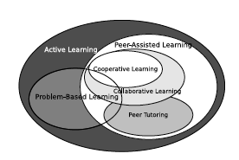

Slide 67
Some Model Elements & Considerations

Slide 68
Chris Dede
“I think that the flipped classroom is an interesting idea if you want to do learning that is largely based on presentation...It is still, in my mind, the old person...
I am interested more in moving beyond the flipped classroom to learning by doing at the center than a kind of the intermediate step that still centers on largely on tacit assimilation.”
Global Education 2011 keynote

Slide 69
Chris Dede
“…educators, who are used to and trained in using class time for lectures, do not know how to transition from a lecture-based classroom to one that includes more student-centered activities…
…A major roadblock or barrier to the implementation of this model is that many educators do not know what to do within the classroom, with that “whatever they want to do” time.”
Global Education 2011 keynote

Slide 70
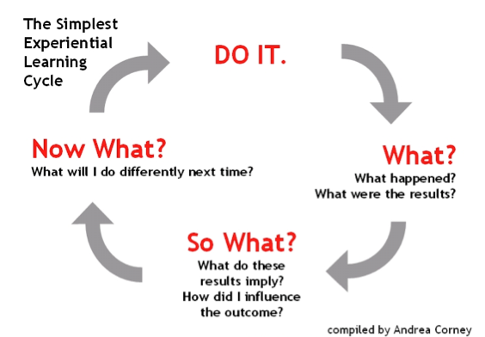

Slide 71
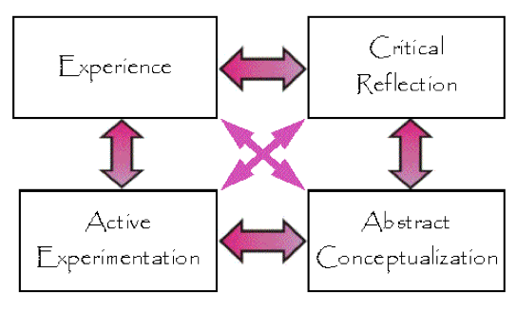

Slide 72
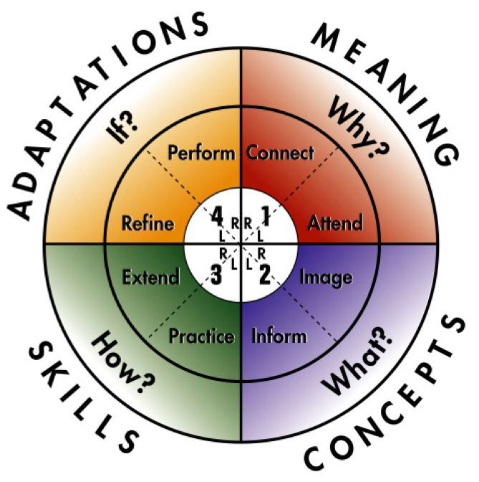

Slide 73
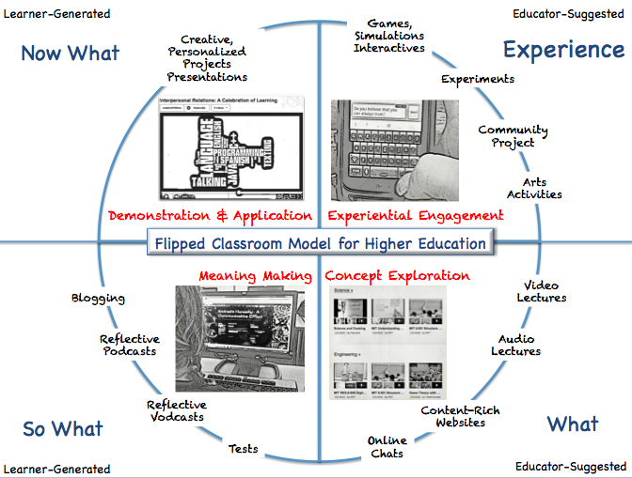

Slide 74
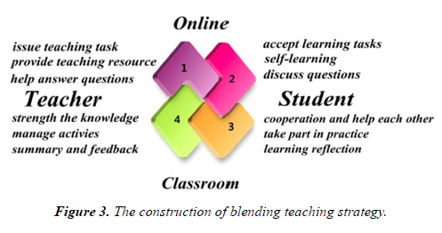

Slide 75
Some Challenges to consider
FC, done well, requires more motivation, more skills, more time, more training on the part of the teacher & student.
VET needs & approaches and education systems are varied – a common structure cannot be too rigid.
The overall approach and intention of the FC (as well as benefits and drawbacks) should be made clear to all stakeholders

Slide 76
An initial suggested “FC4VET” Model (feedback very welcome!)

Slide 77
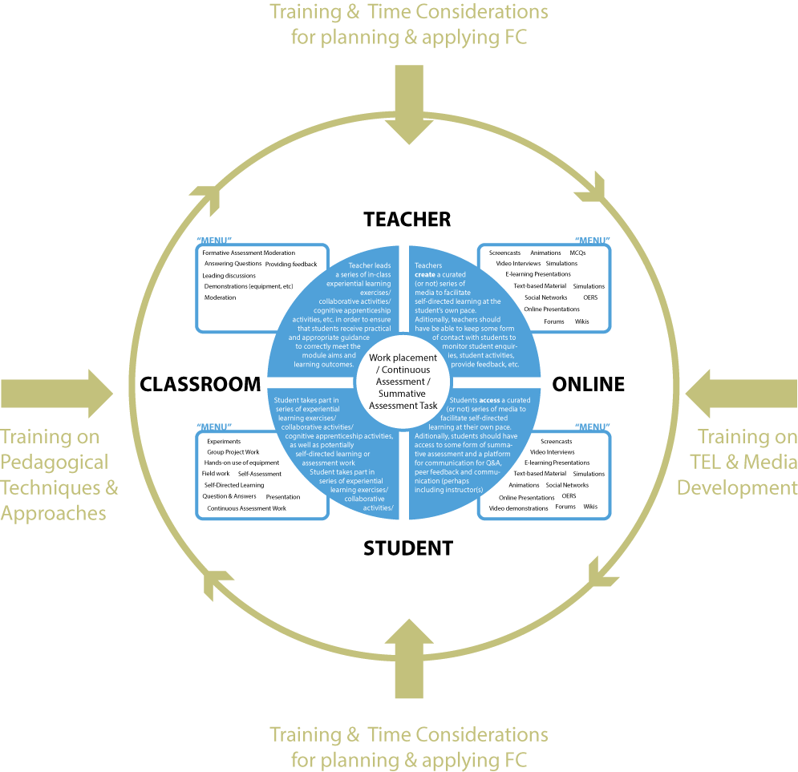

Slide 78
Based on Maria’s Menu...
1. Flipped classroom and the related pedagogical aims and methods
2. ICT tools (web 2.0) for flipping the classroom
3. Open Educational Resources, repositories for use in FC
4. How to create attractive, motivating presentation? Techniques for effective presentation
5. Planning classroom work by integrating FC methods
6. Assessments in FC methods

Slide 79
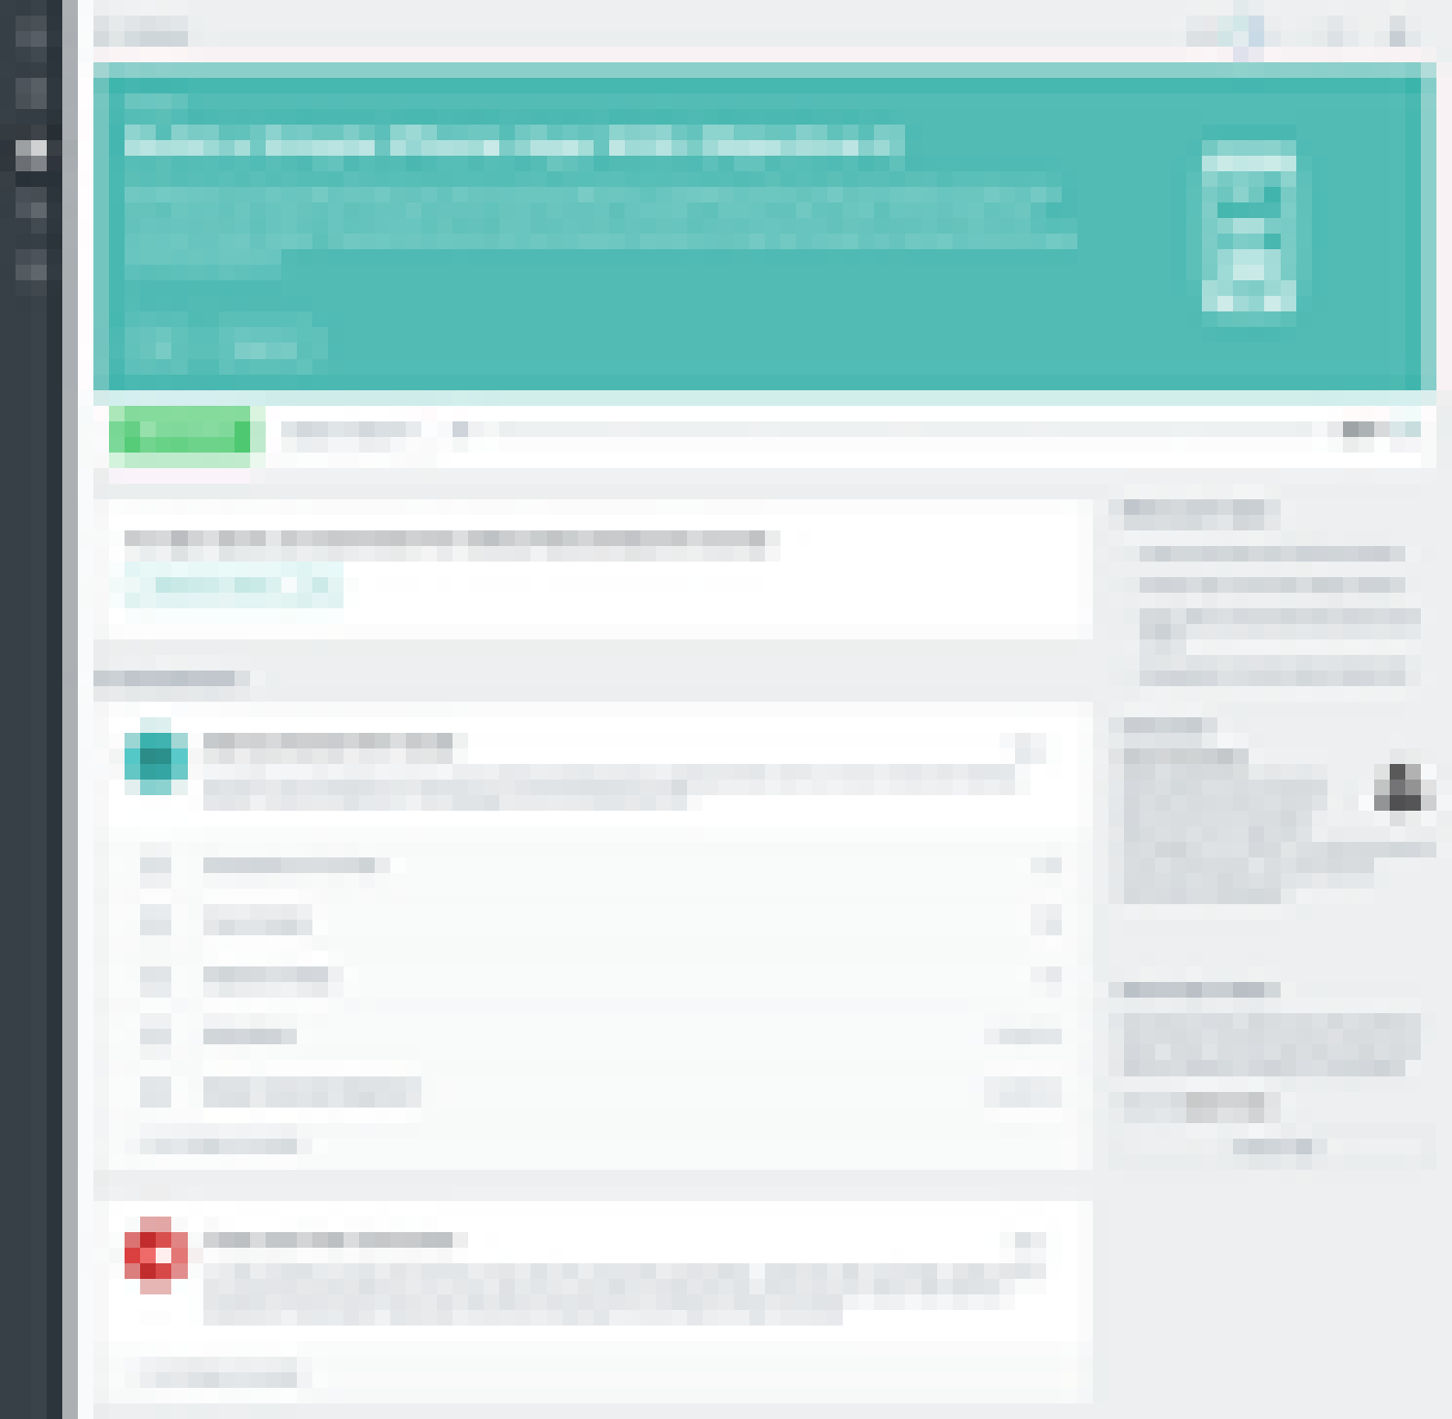
The Bigger Picture
Flexible Environment
Learning Culture
Intentional Content
Professional Educator

Slide 80
…..and looking at what needs attention
Pedagogical systems - learning culture, intentional content, educators
Technological systems - flexibility, affordances
Evaluation methodologies - assessment and course meta-evaluation

Slide 81
…. so in that order

Slide 82
1. Flipped classroom and the related pedagogical aims and methods - a look at pedagogical systems

Slide 83
“Deliberately shifting direct instruction to outside of the group learning space”

Slide 84
Active learning is the grand meta-principle
Why does Flipped Learning work?:
“It is because students are more active in their classrooms.”

Slide 85
Active Learning
In the flipped classroom model, valuable class time is devoted to more active, project-based learning

Slide 88
Active Learning & VET FC
All of these approaches are commonly said to involve “active learning,” defined as “the process of having students engage in some activity that forces them to reflect upon ideas and how they are using those ideas”
(Michael, 2006)

Slide 89
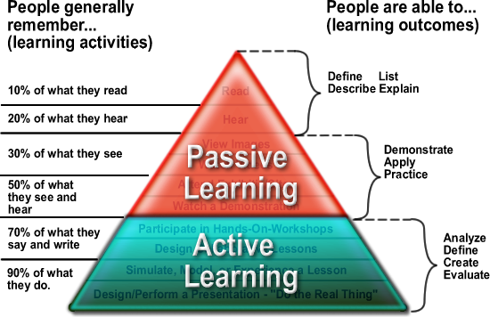
See learners as active
Consider learning as active & dynamic
Provide for social interaction as a part of learning
Let learners learn from each other
Realistic Application and context
“students cannot be expected to learn to deal with complexity unless the have the opportunity to do so”

Slide 90
Multiple perspectives/ representations of content
Give different perspectives and different ways of looking at learning
Nurture self-awareness of learning
Allow learners to go “beyond the information given”
Encourage ownership in learning
Give learners more control and autonomy

Slide 92
A “Menu”
Our suggestion is that the instructor identifies the instructional and pedagogical approaches to suit their own specific learning needs and personal learning journeys - as indicated by student’s responses to questions, tasks and experiences and that training is then provided specifically for these

Slide 93
Collaborative learning
Adaptive learning
Inquiry-based learning
Peer-based learning
Collaborative learning
Cognitive apprenticeships
Problem-Based Learning
Project-based learning
Group work
Experimental Activities
Games for learning/ practice
“Jams”

Slide 94
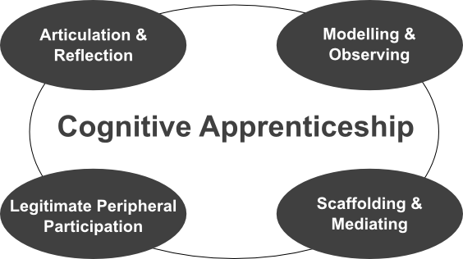
Different to traditional apprenticeships in 3 small but important ways:
Thinking must be “visible”
Situate all learning content in relevant contexts
Provide a diversity of situations for utilizing knowledge and skills

Slide 95
Learners observe an expert model performance
Learners get external support through coaching or tutoring
Learners receive conceptual scaffolding which is gradually faded
Learners continually articulate their knowledge
Learners reflect on progress, comparing their problem solving to expert’s performance
Learners are required to explore new ways to apply what they are learning – ways not yet practiced
Woolfolk p 352 +

Slide 96
Diverse learners

Slide 97
Related instructional mechanisms
Peer Instruction
Priming
Pre-training
Identifying competence
Reflective practice

Slide 98
2. ICT tools for flipping the classroom - technological systems

Slide 99
Firstly looking inwards
Technology infrastructure matters - the recent FlipIT survey useful in guiding decisions on the use of technology.
What were the main takings from this?

Slide 100
There is a demand for instructional technology to get implemented meaningfully.

Slide 101
Clear workflows
Provide clear workflows for content creators
Try and avoid workflows that involve too many tools - the simpler the process the better

Slide 102
No one right tool for all instances

Slide 103
A menu to work from

Slide 104
ICT Tools based on types of activities
Peer Learning Activities (PLA)
Teacher-Directed Learning Activities (TLA)
Student-Centred Learning Activities (SCLA)
Assessment Activities (AA)

Slide 105
Charateristics
Move towards SaaS models with most Educational Applications - some paid, some unpaid - should this be in the “menu” for tools that could be used?

Slide 106
Access
Access to the systems used for delivery should be as straightforward as possible. This involves looking at how the platforms and tools can integrate with:
LMS’
Student information systems
Target devices etc.

Slide 107
3. Open Education Resources - still technological systems

Slide 108
What to consider
Creation/Curation
Quality/Sutabilitity
Localisation

Slide 109
Charateristics
OERs can constitute single pieces of content to entire courses and programs

Slide 110
Some categories to guide us
Some broad categories in relation to OERs
open material
open courseware
open online courses
open-source software and tools to support teaching and learning

Slide 111
OERs can be
Lesson Plans
Readings
Reference
Resource Review
Simulations
Syllabi
Activities and Labs
Assessments
Audio Lectures
Case Study
Full Course
Games

Slide 112
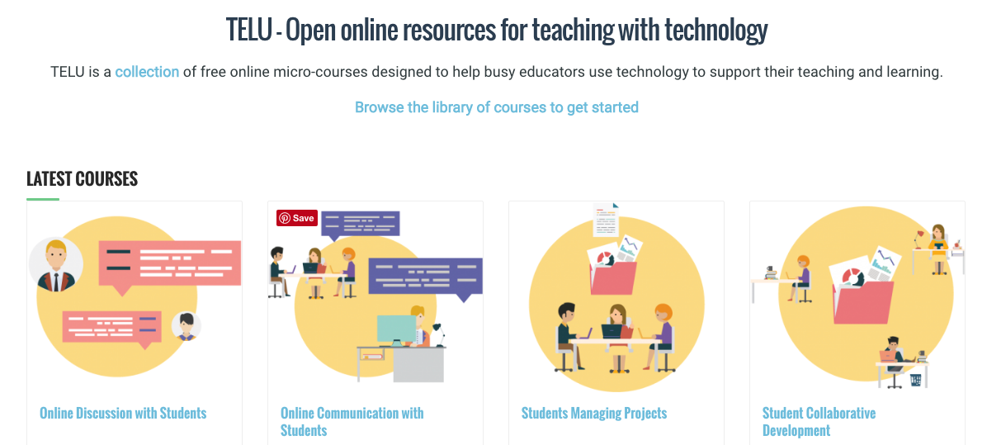
Technology Enhanced Learning Tools for Educators

Slide 113
Assessment Methods

Slide 114
Assessing Flipped Learning
In-class tests
Peer-reviewed presentation
Practical activities
Usually made up of many formative assessment methods

