Slide 1
P7 Opus Learning Ltd Flip IT! Madrid Presentation 24th June 2016
FC Competence Map, Syllabus – Ideas for Discussion
See accompanying discussion paper: o2-a1_cf_draft1f_en.docx

Slide 2
The FC Syllabus(A3) and Competency Framework(A1)...
is designed to be inextricably linked;
needs to be simple and easily understood;
needs to be tested before being developed into a full e-CF framework.

Slide 3
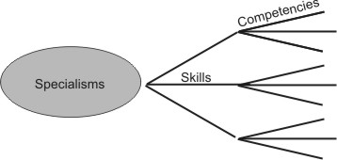
A Competency Framework Approach
EU E-CF
but this is for IT, despite also being used by AAL.
Microsoft example alternative
three levels of hierarchy, but within a domain.
Or for e-CF: Area, Competencies, Proficiency

Slide 4
e-CF Framework Detail
Action: Pedagogy
Dim 1 | Dimension 2 | Dimension 3 |  |  |  |  | Dimension 4
 | Competence | Level 1 | Level 2 | Level 3 | Level 4 | Level 5 | Knowledge | Skills
B | PEDAGOGY
B1 | Instructional strategies
 | Mastering a pedagogic model, and applying to flipped learning
B2 | Alternative teaching practices
 | Help faculty change their teaching practices to favour more active learning strategies (e.g. PBL, Case Studies, Collaborative, Cooperative) |  |  |  | Provides leadership for the change to innovative, alternation learning styles. | Provides IS strategic direction for consensus and commitment from the institution | K1. Alternative strategies K2. Relevance to the institution K3. Impact on teaching | S1. Analyse alternatives S2. Determine requirements for adoption S3. Contribute to the strategic roll-out
B3 | Creating the Need to Know
 | Guidance for students on why they watching/reading a specific text
B4 | Active learning pedagogies
 | Providing opportunites for learners to think critically about content via a range of activities

Slide 5
Alternative Competency Framework Structure?
What value has a simpler framework approach?
three CF hierarchy levels: Specialisation; Skill and Competence;
easier to relate to specific areas of training content and courses;
easier to understand and relate to start with than the dimensions of the EU eCF?
Can still relate to the e-CF and its full development.

Slide 6
Simpler Competency Framework Structure
Level | Name | Example | Description | MCDST Content Map
1 | Environment | Microsoft, Unix, Linux | A competency framework set from a choice within an environment.
2 | Competency Framework Set | Microsoft Desktop Support Technician MCSE, MCSA, MCDBA | Each competency framework set will be subdivided into a number of competency frameworks.
3 | Competency Framework (or Skill Set) | MCDST (1) MCDST (2) | Each competency framework has an associated skill set from which the user can select one or more specialisations against which to self-assess. | Book
4 | Specialisation | Installing Windows XP Installing and Managing Hardware Supporting Network Connectivity | Specialisations are sub-divided into skills, which in turn are sub-divided into competencies. | Chapter
5 | Skill | Installing Hardware in Windows XP Using Windows Troubleshooters Troubleshooting Network Connectivity Managing Disks Remotely Understanding Removable Storage | Individual experience (No of months) is specified at the Skill Level. Competence, Ability and Expertise Points can be accumulated at the Skill Level. Competence Points give an overall view of capability in the Skill Ability Points are indicative of the spread of capability across the competences defining the skill Expertise Points reflect capability and experience. | Lesson
6 | Competence | Understanding Plug and Play Devices Troubleshooting Networking Hardware End Users Level of Expertise Traits of a qualified DST | Users assess competence at a rating of 0-3 against the lower level competence definitions. | Sections within a Lesson

Slide 7
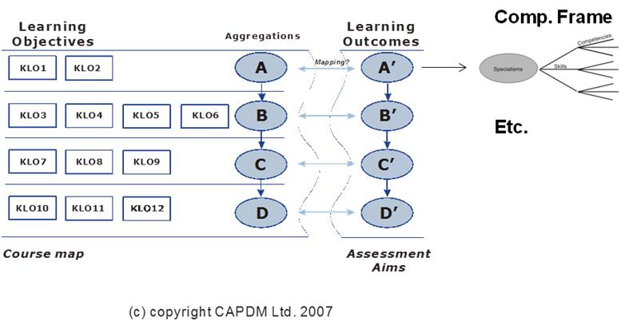
Mapping to Content
Dimension 1 Areas can be directly mapped to the Learning Outcomes that would be the focus of the assessment of a course.
These, in turn, should be the focus of the Learning Objectives of the course materials and course structure.
This structure, then, can act as a guide for the development of a course and content.

Slide 8
Example 1: Direct FC Approach
Specialism | Skill | Competencies
A. CONTENT | A1. Designing activities | A1.1. Exploiting learning opportunities
 |  | A1.2. Creating learning plans
 |  | A1.3. Incentivising and gamification
 | A2. Higher order thinking skills | A2.1. From knowledge to evaluation
 |  | A2.2. Meeting cognitive demands
 | A3. Reinforcing learning objectives | A3.1. Matching activities to learning objectives
 |  | A3.2. Integrated course design
 |  | A3.3. Assessment Opportunities
B. PEDAGOGY | B1. Instructional strategies | B1.1. Choosing suitable strategies
 |  | B1.2. Re-inventing the lecture
 |  | B1.3. Preparing students for societal roles
 |  | B1.4. Aligning with competencies
 | B2. Alternative teaching practices | B2.1. Analyse alternatives
 |  | B2.2. Determine requirements for adoption
 |  | B2.3. Contribute to the strategic roll-out
 | B3. Creating the Need to Know | B3.1. Reasons for learning
 |  | B3.2. Embedding in the content
 |  | B3.3. Discovering meaning and relevance
 | B4. Active learning pedagogies | B4.1. Adopting and modifying active learning techniques
 |  | B4.2. Explaining the learning benefits
 |  | B4.3. Facilitating the processes
 |  | B4.4. Control and coordination

Slide 9
Example 2: EU e-CF Aligned
PLAN; BUILD; OPERATE; ENABLE; MANAGE
Specialism | Skill | Competencies
A.PLAN | A1. Instructional strategies | A1.1. Choosing suitable strategies
 |  | A1.2. Re-inventing the lecture
 |  | A1.3. Preparing students for societal roles
 |  | A1.4. Aligning with competencies
 | A2. Alternative teaching practices | A2.1. Analyse alternatives
 |  | A2.2. Determine requirements for adoption
 |  | A2.3. Contribute to the strategic roll-out
 | A3. Creating the Need to Know | A3.1. Reasons for learning
 |  | A3.2. Embedding in the content
 |  | A3.3. Discovering meaning and relevance
 | A4. Active learning pedagogies | A4.1. Adopting and modifying active learning techniques
 |  | A4.2. Explaining the learning benefits
 |  | A4.3. Facilitating the processes
 |  | A4.4. Control and coordination
B. BUILD | B1. Designing activities | B1.1. Exploiting learning opportunities
 |  | B1.2. Creating learning plans
 |  | B1.3. Incentivising and gamification
 | B2. Content creation & presentation | B2.1. Relevance, engaging and interesting
 |  | B2.2. Provide opportunity through different approaches
 |  | B2.3. Provide the support need to reach goals

Slide 10
checking whether a competency framework is fit for purpose
Communicate the purpose – Do the target users of the CF understand what the purpose is.
Identify key themes – It still needs to support the organisation’s aspirations (goals, values, business plans, and so on).
Get conditions right – The organisation’s procedures, culture, resourcing and management structures are supportive too.
Tackle the root causes – Don’t trying to improve behaviour without tackling the root causes.
Keep it simple – Two key elements to ease of use – language and structure. If it’s too complicated, long or detailed it won’t be used.
Train, don’t blame – Users must be trained how to use it, or it will fall into disuse or fail to meet its full potential.
Source: UK CIPD

Slide 11
Flip IT! Development Stages?
Develop and initial CF using simply Microsoft approach.
Derive the first Syllabus.
Produce the Course.
Run the Course.
Summarise Feedback.
[Optional step] Produce eCF version with full industry collaboration.

