Slide 1
Flipped Classroom
Pedagogical Model

Slide 2
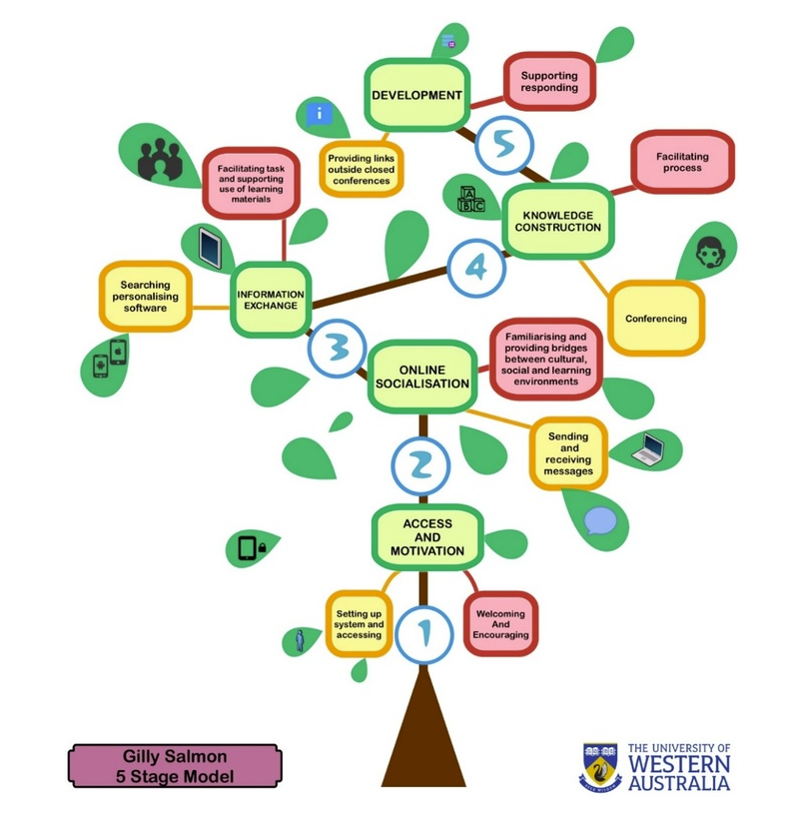
Pedagogical Model
“Pedagogical models are cognitive models or theoretical constructs derived from learning theory that enable the implementation of specific instructional and learning strategies. Examples of pedagogical models include anchored instruction, problem-based learning, cognitive apprenticeship, situated learning, and computer-supported intentional learning environments”

Slide 3
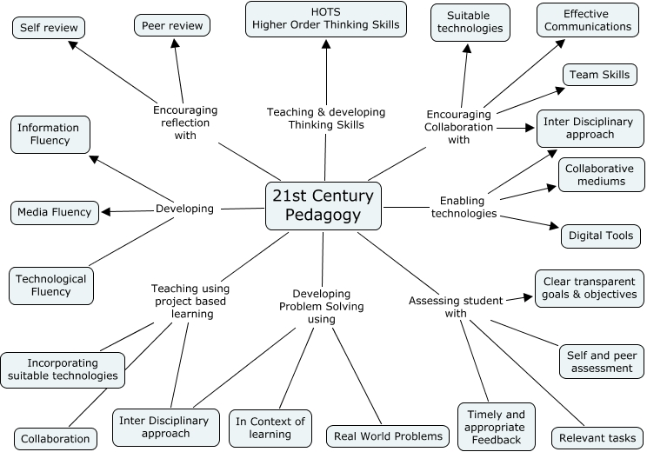
http://www.teachthought.com/

Slide 4
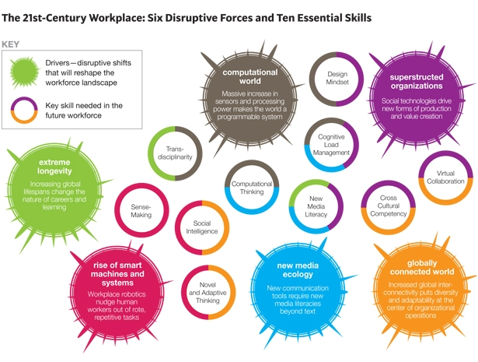
Future Work Skills 2020
Anna Davies, Devin Fidler, Marina Gorbis
©2011 Institute for the Future for University of Phoenix Research Institute

Slide 5
Creativity and innovation
Critical thinking, problems solving
Communication and collaboration
Flexibility and adaptability
Initiative and self-direction
Social and intercultural skills
Productivity and accountability
Leadership and responsibility
Information literacy
Media literacy
ICT skills

Slide 6
ET 2020 - 2015
Fostering creativity, entrepreneurship and mobility
in education
and training
(2009)
Turn the traditional teaching into creative and innovative methods like
project-based,
inquire-based,
problem-based,
work-based,
problem-based methods.
Opinion of the European Economic and Social Committee on Fostering creativity, entrepreneurship and mobility in education and training (Official Journal of the European Union, C 332/20, 2015

