Slide 1
Fast, creative drawing using digital board The first attempt
Presentation of
WACOM Intuos Art Pen&Touch S
Sára Ekert
florist teacher
Flip-it!
Madrid, Spain
23-24. June 2016

Slide 2
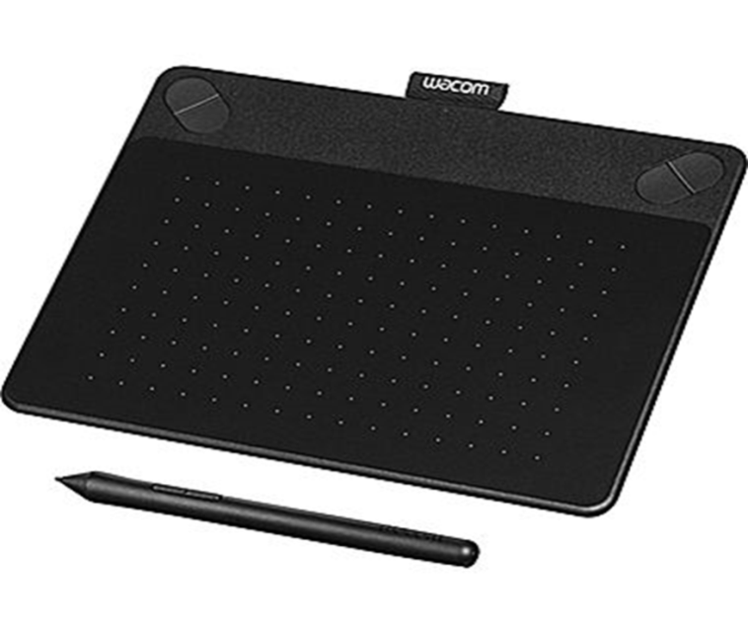
The digital drawing board and its accessories
tablet + cable
pen + replacement nibs
Installation disc

Slide 3
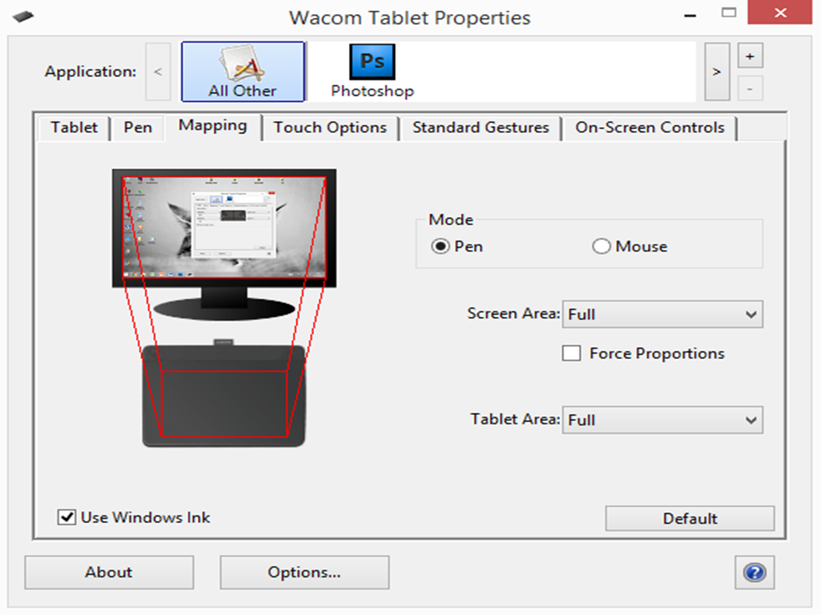
Available functions and settings
Adjustable main parameters
Tablet
Pen
Mapping
Touch Options
Standard Gestures
On-Screen Controls

Slide 4
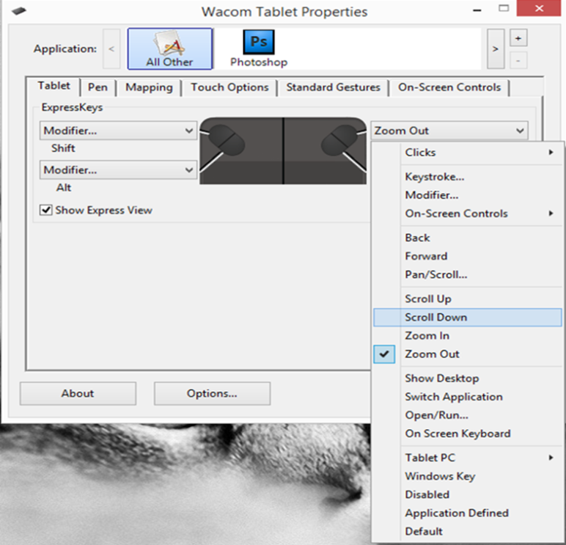
Available settings and functions
Tablet – 4 (available functions: zoom, replacement of fast button combinations, scroll, open
Pen – setting of 2 keyboard shortcuts, pressure sensitivity,
The keyboard shortcuts help to access the most often used functions
Mapping - the way of using the tablet
1. Touch screen
2. mouse

Slide 5
Available settings and functions
Touch options
multi touch, setting of touch – speed of magnifying, speed of pen movement
Standard Gestures
Setting of finger control (rotate, move, zoom, scroll)
On-Screen Controls
Setting of button control – pl. ctrl+shift+z - undo

Slide 6
Individual settings
Left and right handed users
Set to individual habits
Different settings can be saved for each program
Fast and comfortable use

Slide 7
Application graphics software
Digitalizing tablet can be use for the most graphics softwares
Photoshop, Adobe Illustrator, Gimp, Corel Draw
for digitalizing, painting
Advantages: can be modified easily (form and colour, figures, compositions)
Helps the presentation during lessons, attaches the ideas easily and fast
Long-lasting, storable format
Our ideas can be shared

Slide 8
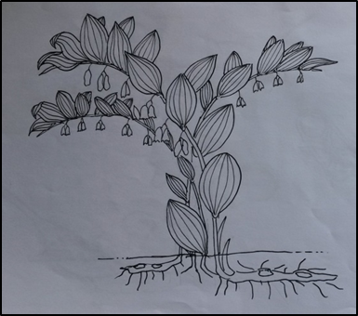
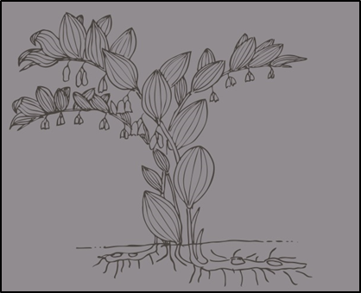
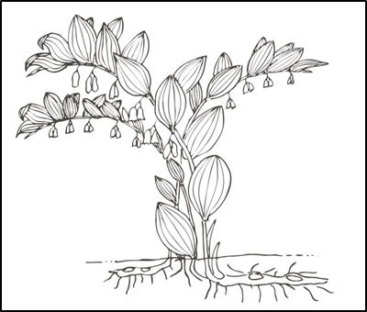
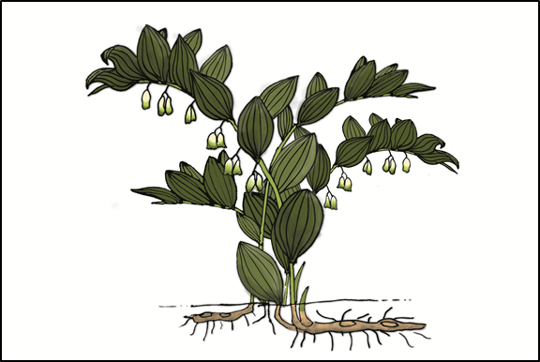
Digitalizing of paper based drawings
vectorising – contour - colouring – final illustration

Slide 9
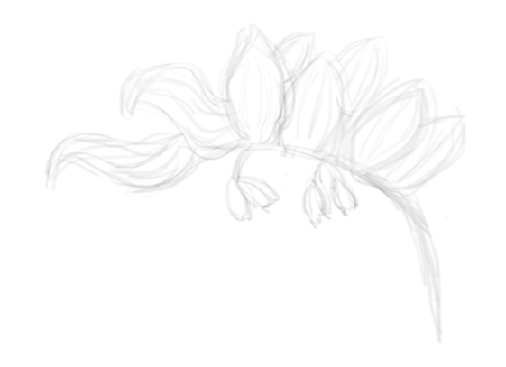
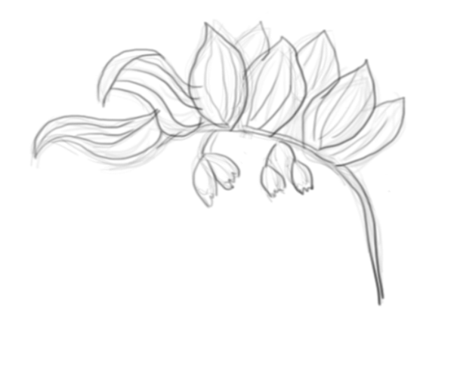
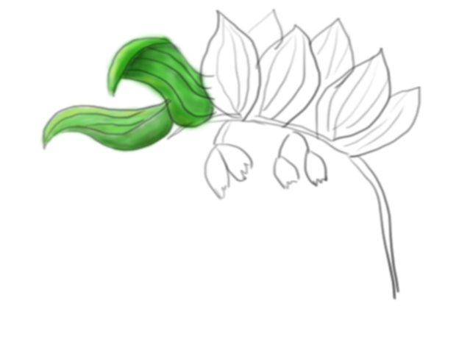
From skech to final picture
Solomon's seal

Slide 10
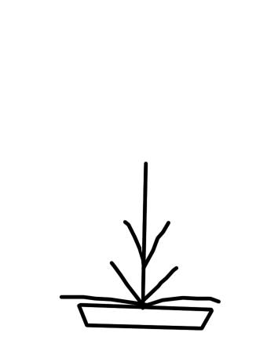
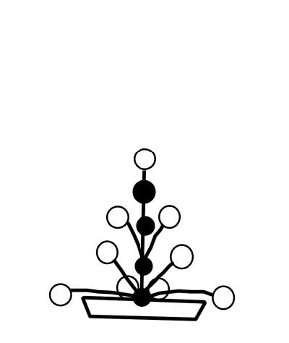
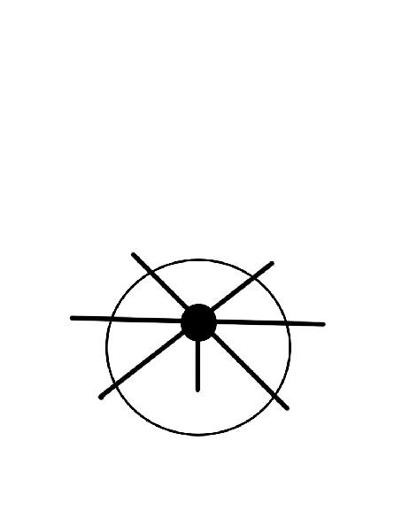

Slide 11
Flow chart

Slide 13
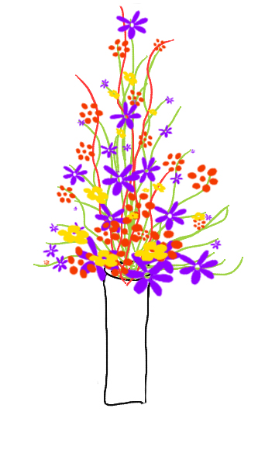
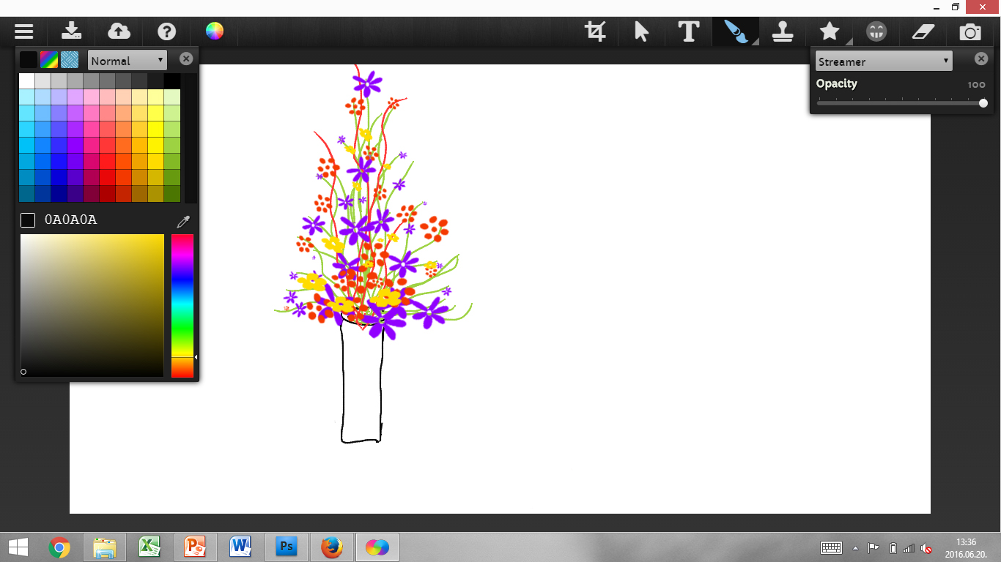
Sketchpad program

Slide 14
Thank you for your attention! ☺

