Slide 1


Flipped classroom in Spain
State of the art
Dra. Sara Redondo
Center of Research in Education
Universidad Europea
INTERNAL USE/ Sara Redondo

Slide 2
Content
State programs to foster the use of ICT in schools
Teacher training program on ICTs
Flipped classroom course- Ministry of Education
Examples of resources for FC in VET
Case study 1
Case study 2
Case study 3

Slide 3
1. State Programs to foster the use of ICT in Schools
Internet in the classroom Program
School 2.0 Program
2005-2008
453.5 m€ investment
Computer equipment and infraestructure
Training of teachers
Social network
Network of advanced centers in the use of ICT
2009-2012
Budget of 200 m€
5th and 6th course of Primary Education
Laptops for students and teachers
Secure Internet connectivity
Generate digital educational materials

Slide 4
2. Technology- related teacher training programs
Educational technology courses offered by the Ministry of Education:
Tutors for network training
Personal Training Environment: Network learning
Mobile learning and augmented reality
Education Portfolio as instrument of learning
Education connected in real time
Digital Story telling
Multiple literacies
Creation of open educational resources
Flipped classroom
From spectator to programmer

Slide 5
3. Flipped classroom course (Ministry of Education)
Duration: 70 hours
Objectives:
To analyze the application of this model to the context of Primary and Secondary education.
To analyze the advantages of its development as well as the issues or problems that we can find when it comes to putting it into practice.
Modules:
Why to use FC in the classroom
History and underlying concepts of FC
The efficacy of FC model
Tools and resources
Active methodologies and FC
Problems you can find when applying FC

Slide 6
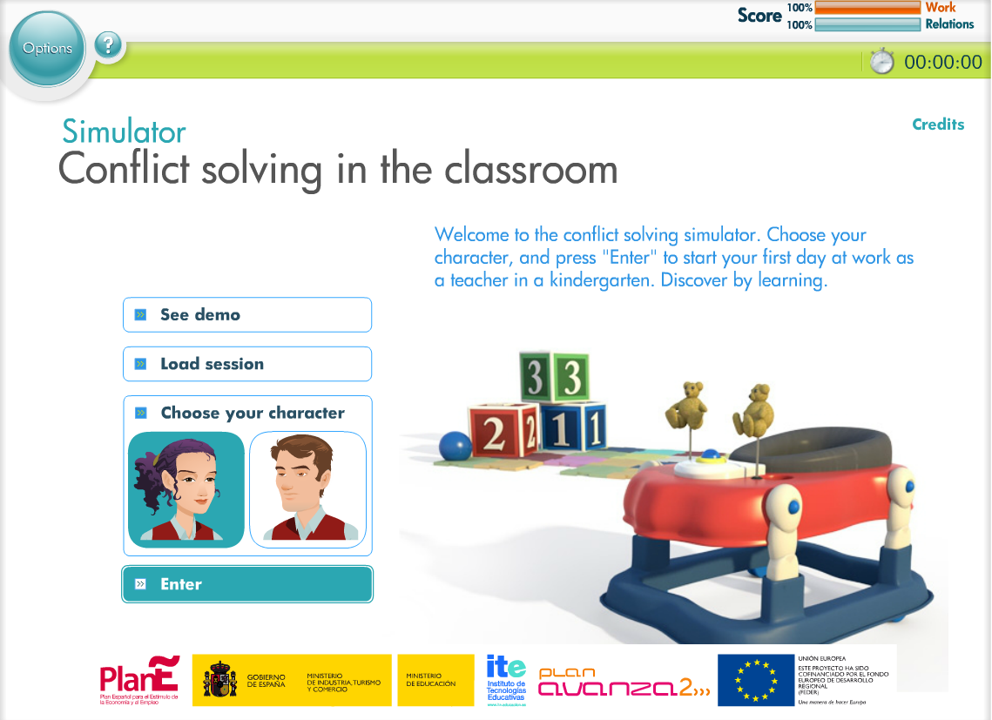
4. Resources for FC in VET
Good practices
Educ@conTIC
Simulators for training
Technological observatory
Educational resources (Procomún)
Agrega Platform

Slide 7
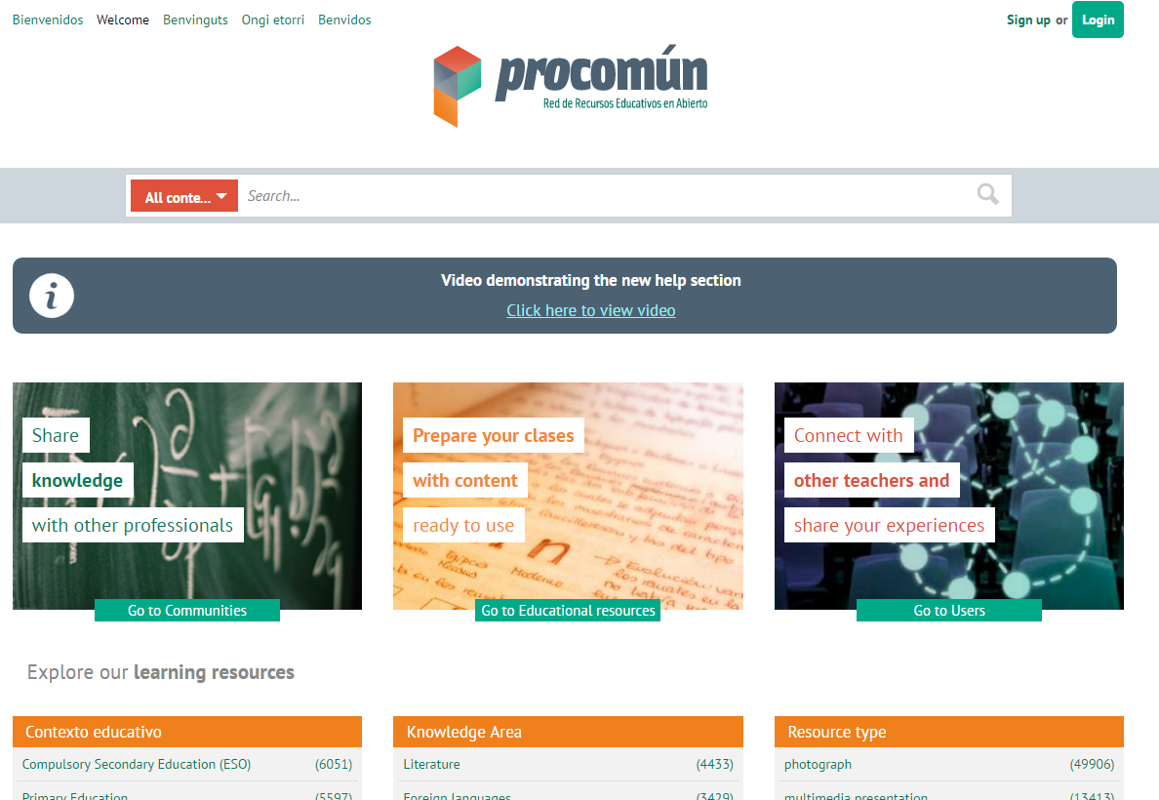

Slide 8
5. Research on FC in Spain
In Spain the first registered research on this level was covered by Camacho (2014) in Computer Science (Multiplatform Application Development - MAD) in Universidad Europea de Madrid.
The platform www.theflippedclassroom.es is one of the main aggregators of FL experiences in the Spanish scene.

Slide 9
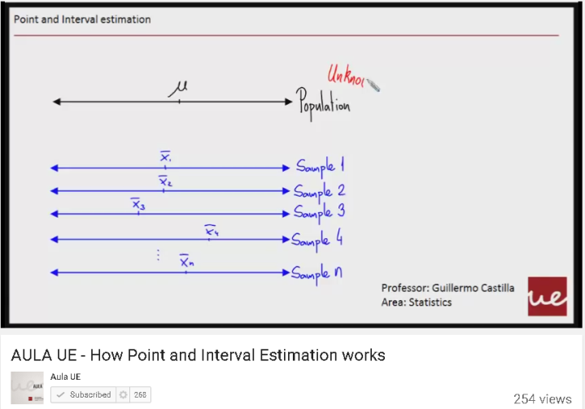
6. Case study 1
Subject: Statistics (for Engineers) in UEM- Undergraduate
Methodology:
Results:
Attendance grew around a 10%
Grades grew around 20%.
Greater self-perception of knowledge was qualitatively perceived.
Greater long term knowledge persistence was recorded around a 6%.
Materials
Multimedia content was created and uploaded to a specific Youtube channel called Aula UE
Tools
Moodle
Educational activities
Statistical problems solved collaboratively in the classroom
Youtube

Slide 10
7. Case study 2
Program: Development of multiplatform applications (UEM)-VET
Subject: Databases
Methodology:
Online
Watch 10- minutes videos
Campus-based
Self-assessment tests (40%)
Educational activities
Self-assessment tests (before classes)
Lab sessions (in class)
Cooperative lab activities in each session.
Some conclusions:
Do not flip the whole subject, at least the first time
Create specific media contents
Greatest resistance: Top students

Slide 11
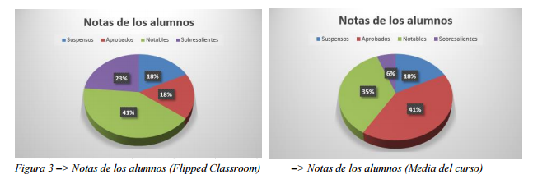
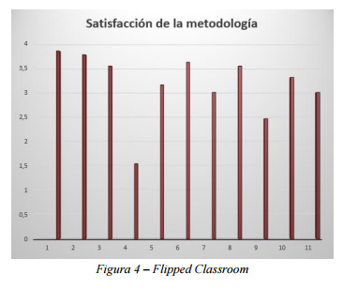
Case study 2
Some results:
  High satisfaction (7,5/10)
  Higher grades than in other subjects
  Less drop-outs and improved attendance
Source: Camacho Ortega (2014)

Slide 12
Case study 3
Program: Master's Degree in Teacher Training for Secondary School
Methodology:
Results:
Initial resistance to change the methodology
Greater participation and motivation
It requires more time from the teacher and the students
Students are satisfied with multiple aspects
Students have the self-perception of having increased their learning outcomes.
Most students prefer FL to traditional methodology
Online
Before class (at home): videos and documents, self-assessments tests
Tools
Socrative, Educanon
Educational activities
FL activities (60%): self assessment tests (10%) + webquest (15%) + Project (20%) + Portfolio (15%)
Reflective portfolio
Camtasia Studio 8
Learnist
Moodle and Edmodo
Individual exercises (40%)

Slide 13






CANARIAS
INTERNAL USE/ Nombre del propietario

