Slide 1


LEARNING
METHODOLOGY AND PRACTICE IN SPAIN
Maite Villalba (maite.villalba@uem.es)

Slide 2
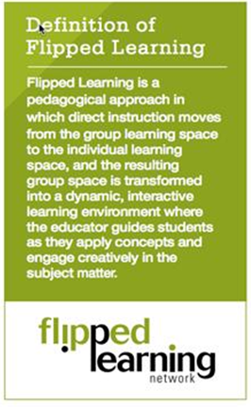
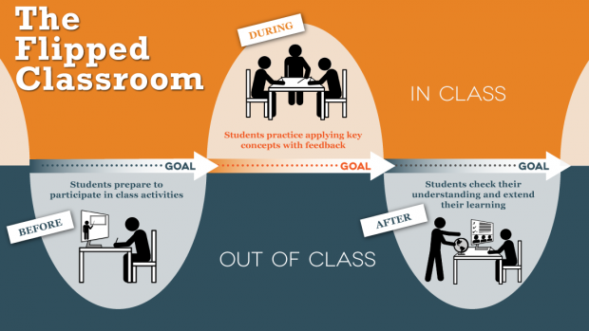
WHAT IS Flipped Learning?
Giving students an active role in his education
Making them the center of his own learning.
Teachers role more that of a guide, of a supporting figure.
Notes:
Modelo -> representación teórica
Metodología -> concreción del método en un contexto determinado

Slide 3


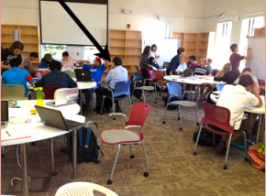
How it worked?
Teachers create or search videos or other attractive resources
Students watch 7-10 minutes videos, surf websites, listen podcast, etc. at their own pace
Class time is spent doing labs or interactive activities to illustrate concepts.

Slide 4

PILLARS of FC
Flexible Enviroment
Teachers create flexible environments in which students choose when and where they learn.
Educators are flexible in their expectations of student timelines for learning and how students are assessed
Learning Culture
Shift from a teacher-centered classroom to a student-centered approach
Students move from being the product of teaching to the center of learning
Intentional Content
Educators evaluate what content they need to teach directly, and what materials students should be allowed to explore first on their own outside
Professional Educator
Professional Educators are more important than ever, since they must determine what, when and how to shift direct instruction from the group to the individual learning space, and how to maximize the face-to-face time between teachers and students
Notes:
There is the misconception that FC is to create videos for theoretical classes and use ICT in the learning process, but there is much more: teachers need to plan carefully the sessions in order to meet the learning objectives; choose the lessons that can be flipped and ensure that students understand and learn the concepts given outside classes; prepare the collaborative sessions to be meaningful, and design the

Slide 5
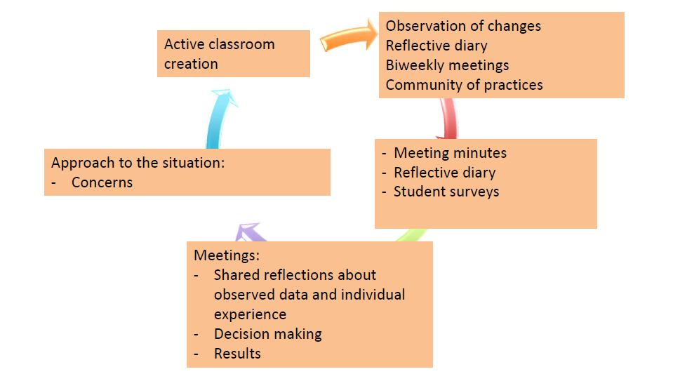
Flipped Classroom in UEM
Research-Action methodology
A group of professors applying FC methodology and reflecting about the results

Slide 6
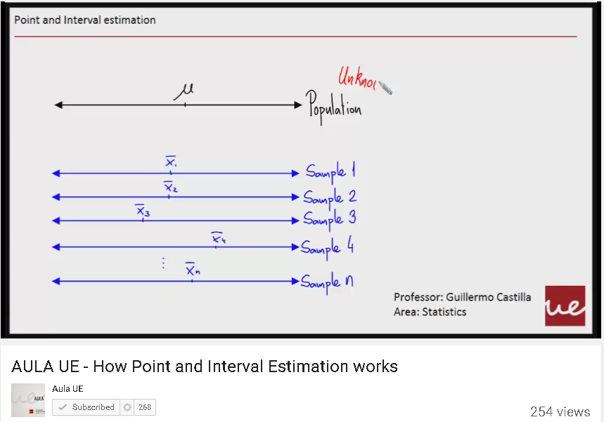
Case study 1 – Higher Education
Statistics (for Engineers) in UEM
Paper published in: http://library.iated.org/download/INTED2015TOC
Methodology:
Multimedia content for the classes was created and uploaded to a specific Youtube channel called Aula.
Proposed statistical problems would then have to be solved collaboratively and handed in by the end of the class
https://www.youtube.com/watch?v=7EBSIBumtwE
Notes:
First half of the subject: Traditional lecturing (Master classes)
Individual project (10% of assessment)
Mid-term test (20%)
Initial self-perception of learning survey.
Second half of the subject: Flipped Classroom
Collaborative sessions (30%)
Final Exam (40%)
Final self-perception of learning survey
Long term knowledge persistence

Slide 7
Case study 1 – Higher Education
Some results:
Attendance grew around a 10%.
Grades grew around 20%.
Greater self-perception of knowledge was qualitatively perceived.
Greater long term knowledge persistence was recorded around a 6%.
Some conclusions:
Do not flip the whole subject, at least the first time
Create specific media contents
Greatest resistance: Top students

Slide 8
Case study 2 – VET
Development of multiplatform applications (UEM)
Subject: Databases
Paper published in: http:// http://abacus.universidadeuropea.es/handle/11268/3464
2 academic years using FC, 1 lesson (1 month)
Methodology:
10-minutes videos
Self-assessment tests
Notes:
Advanced Career and Technical Education

Slide 9
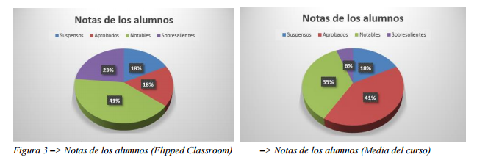
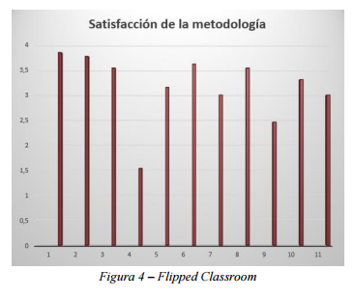
Case study 2 – VET
Some results:
High satisfaction (7,5/10)
Higher grades than in other subjects
Less drop-outs and improved attendance

Slide 10
Other examples in UEM
Bachelor's Degree in Physiotherapy:
customized TEDEd lessons with questions and activities to make at home,
clinic cases to solve in classroom,
Twitter for formative assesment
Bachelor's Degree in Phycology:
videos and written materials available online,
Specific classroom activities.
Bachelor's Degree in Marketing
Bachelor's Degree in Law….
They are all experiences with only a part of the syllabus

Slide 11
State-of-art in Spain – HE
Great number of experiences of FC in HE in Spain
Master's Degree in Teacher Training for Secundary School
At home: Videos and documents, self-assesment tests (Socrative or Educanon)
Classroom: collaborative activities
http://dialnet.unirioja.es/servlet/articulo?codigo=5189994
Bachelor's Degree in Nursing
Similar methodology
http://library.iated.org/view/BRANDOGARRIDO2013EVA
Notes:
That´s not an exhaustive research

Slide 12
State-of-art in Spain – not HE
Secundary school, Biology : https://www.educanon.com/public/1409/13250
Secundary school, History: https://sites.google.com/a/iesvirgendelcastillo.es/historia2bachillerato/?_ga=1.131875595.566343537.1444215302
Secundary School, Latin: http://www.theflippedclassroom.es/flippeo-luego-aprendo/
Community flippedEABE: https://plus.google.com/communities/109884545472617380981
Notes:
That´s not an exhaustive research

Slide 13
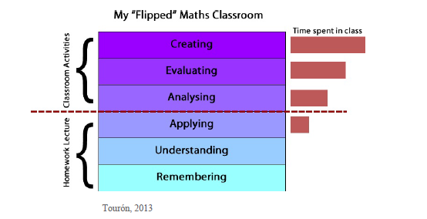
PROS - Flipped learning
Promotes autonomy and personalized learning.
Increases opportunities for in-class interaction
Greater self-perception of knowledge.
High student satisfaction.
Increase in class attendance and motivation
Teacher and students can focus on the upper levels of the Boom taxonomy (applying, analyzing, and creating)
teacher moves understanding and remembering to outside of the group learning space
Notes:
In traditional classrooms, learners put most of their effort into the lower levels of Bloom’s Taxonomy--understanding and remembering--as they attempt to follow the teacher’s instructional delivery. In the flipped classroom, the teacher moves lower levels of the taxonomy to outside of the group learning space, where students can then work on mastering concepts on their own time and pace. When using video, for example, students can pause, rewind, and review the lesson at any time. In class, the teacher and students can then focus on the upper levels of the taxonomy (applying, analyzing, and creating). This has potential to allow struggling learners more opportunities to understand and improve their recall before they come to class, as previously described in the research on cognitive load. Flipped Learning model increases opportunities for in-class interaction .

Slide 14
CONS - Flipped learning
Does every student have access to the technology being used to set the homework assignments? Is the infrastructure in place?
There is no interaction, a space to ask doubs should be provided
What about those students who do not do homework anyway?
Teachers have busy schedules, so where do they get the time to make videos or other specific resources?
Most teachers do not have the skills to make videos.
How can a 10-min video replace a lecture that take an entire class period?
Some students dislike this learning environment because they prefer receive material passively in class.
Notes:
When I was in School teachers asked for assignments for which we needed to use encyclopedias, and it was no an excuse for me not to get my work done, it was up to your parents to go to the library or whatever.

Slide 15
CONCLUSIONS
The course must be redesigned:
Selecting the course content to be flipped outside of classroom by reading, watching recorded lectures, etc.
Incorporating active learning to work at class
Adopting collaborative strategies to create a more student-centered learning environment.
Choosing the appropriate tools for assessment
Strategies to deal with resistance to change need to be defined
Notes:
When I was in School teachers asked for assignments for which we needed to use encyclopedias, and it was no an excuse for me not to get my work done, it was up to your parents to go to the library or whatever.

Slide 16





LAUREATE
INTERNATIONAL
UNIVERSITIES
At present
More than 1.000.000 students
More than
80 institutions
More than 29 countries

