Slide 1
FLIP IT Lesson Planning Lesson Study
Martina Maněnová
Věra Tauchmanová

Slide 2
Lesson Planning
Sources:
Milkova, S. Strategies for Effective Lesson Planning
Vondrová et al. “Lesson study“ v českých podmínkách
Singapore Management University: Lesson Planning
www.crlt.umich.edu: Improving your teaching

Slide 3
Lesson Planning
Key components:
Objectives of the students´ learning
Teaching / learning activities
Strategies to check the students´ understanding
Every lesson plan – achievement of the objective, connection to long-term instructional goals

Slide 4
Lesson Planning
1. Identify the learning objectives – a)
What is the topic of the lesson?
What do I want the students to learn?
What do I want them to understand and be able to do at the end of class?
What do I want them to get out of this particular lesson?
The students should understand WHY they are taught the lesson and WHAT they can expect to get out of it.

Slide 5
Lesson Planning
1. Identify the learning objectives – further considerations to be made by teachers
What are the most important concepts/ideas/skills I want students to be able to grasp and apply?
Why are they important?
If I ran out of time, which ones could not be omitted?
Which ones could I skip if pressed for time?

Slide 6
Lesson Planning – step 1 in FC
& Instructional Strategies
Is the material effective and relevant?
Do the students have access to the material?
Do the students know how to use the material?
Describe what students will need to be able to know and do using active verbs from Bloom’s revised taxonomy (http://www.celt.iastate.edu/teaching/effective-teaching-practices/revised-blooms-taxonomy

Slide 7
Lesson Planning – step 1 in FC
& Instructional Strategies
Choose the evidence based instructional approach
which fits the main learning activity
Start small!
Don´t try to make perfect videos!
Present what the students struggle with!

Slide 8
Lesson Planning
2. Plan the specific learning activities
What will I do to explain the topic?
What will I do to illustrate the topic in a different way?
How can I engage students in the topic?

Slide 9
Lesson Planning
2. Plan the specific learning activities – cont
Are there relevant real-life examples, analogies, or situations that can help students understand the topic?
What will students need to do to understand the topic better?

Slide 10
Lesson Planning – Step 2 for FC
2. Plan the specific learning
activities
The pre-class work should set the scene for the in-class activity. Plan how you will communicate the new instructional ideas. Would students benefit more from watching a video demonstration outside of class at their own pace and as often as needed or would some other media type be more effective?

Slide 11
Lesson Planning – Step 2 for FC
2. Plan the specific learning motivating
activities (to prepare before class)
What kinds of activities will motivate students and prepare them for class? What should students be able to do to prepare for class? What questions will the students be asked?
Identify the kinds of incentives or motivations that will engage students in the instructional material and prepare them for the in-class activity.
Determine how you can provide feedback to students about what they know and do not know prior to class.

Slide 12
Lesson Planning – Step 2 for FC
2. Plan in-class activities that provide students opportunities to deepen understanding
What kind of in-class activities will focus students to attain higher-level cognitive abilities? Align & match these activities with the learning objectives.
In all these examples prepare clear instructions for distribution to students in-class.
Use a timeline work plan to help you keep manage the activity and keep students on task.
.

Slide 13
Lesson Planning – Step 2 for FC
2. Plan post-class activities that extend student
learning
How will students continue the learning experience from the inside class activity to outside of class? (We do not retain well what we may learn from just one exposure to the materials.)
Describe how you will connect this lesson to the next lesson so that they flow coherently.
What kind of in-class activities will focus students to attain higher-level cognitive abilities?
.

Slide 14
Lesson Planning – Step 2 for FC
2. Plan post-class activities that extend student
learning
Prepare clear instructions for distribution to students in-class.
Use a timeline work plan to help you keep manage the activity and keep students on task.

Slide 15
Lesson Planning
3. Plan to assess student understanding
The number and type of assessment
Examples of different assessments
Formative and/or summative
The criteria and standards
Rubrics
Students roles
Self-assessment
Peer assessment

Slide 16
Lesson Planning
3. Plan to assess student understanding – cont.
Considerations about individual assessment tasks and methods through which individual assessments will be combined into the final grade for course
The provision of feedback

Slide 17
Lesson Planning
4. How to sequence the lesson in an engaging and meaningful manner (SMU, 2017)
4. Plan to sequence the lesson in an engaging and meaningful manner

Slide 18
Lesson Planning
5. Create a realistic timeline for all the
phases - Be flexible!
Estimate how much time each of the activities will take
Plan a few minutes at the end – any remaining questions, a summary of the key points
Plan an extra activity or a question for discussion

Slide 19
Lesson Planning
6. Plan for the closing-up of the lesson
For teachers:
Check the students´ understanding, give subsequent instructions
Emphasise and summarise key information
Tie up loose ends
Prewiew upcoming topics

Slide 20
Lesson Planning
6. Plan for the closing-up of the lesson
For students:
Demonstrating of their understanding of the major points
Consolidation of the key information
Leaps and bounds of the lesson ideas
Transferring ideas to new situations

Slide 21
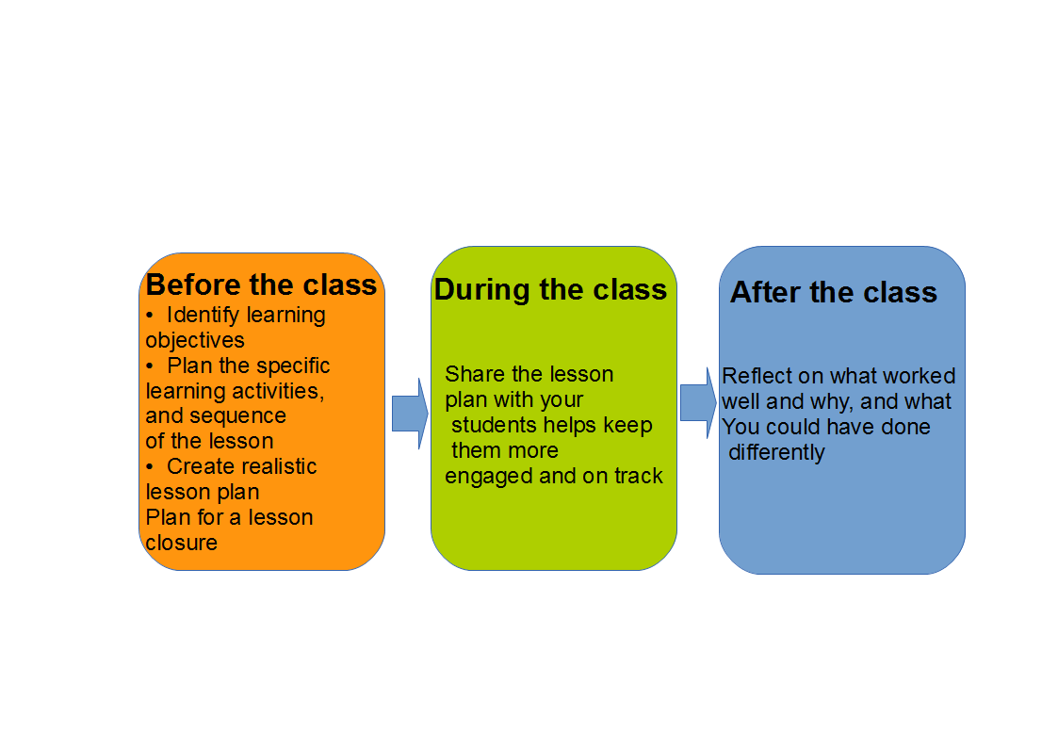
Lesson Planning - Summary

Slide 22
Lesson Study
What is it?
Learning from other colleagues and supporting the staff through triads.
Putting the power back into the classroom: teaching and learning.
It is a model of collaborative CPD (continuing professional development) where a group of you plan a lesson together, observe each other and reflect on learners´ progress.

Slide 23
Lesson Study
What is it?
A way of empowering staff to develop and reflect on their own teaching in the classroom.

Slide 24
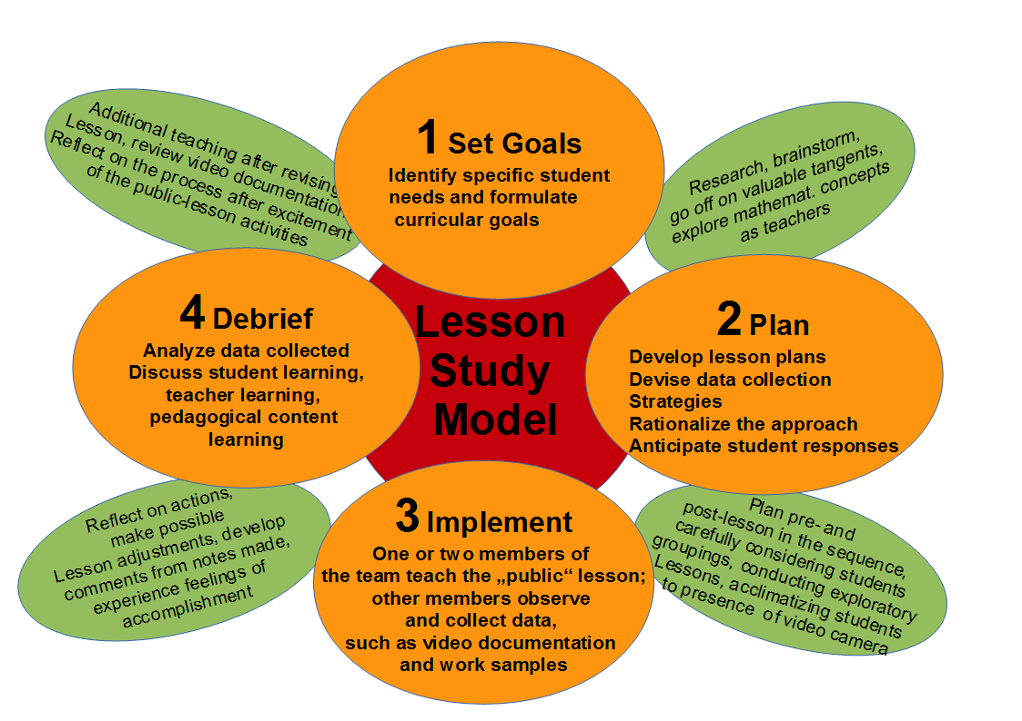
Lesson Study

Slide 25
Thank you for your attention.

