Slide 1


Flipped Classroom
Practice in the Czech Republic
Martina Maněnová
Věra Tauchmanová

Slide 2
University of Hradec Králové
Faculty of Education
A teachers´ training college for the following levels:
pre-primary
primary
lower secondary
upper secondary

Slide 3
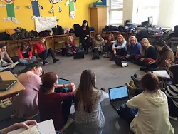
University of Hradec Králové
Faculty of Education
ICT in education

Slide 4
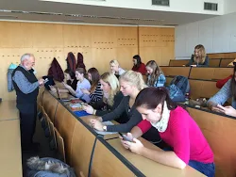
University of Hradec Králové
Faculty of Education
ICT in education

Slide 5
FC course – pre-service teachers
Participants – 1st and 3rd year university students majoring in teaching at primary schools
Students registered in the course: 63
(2 male students, 61 female students)

Slide 6
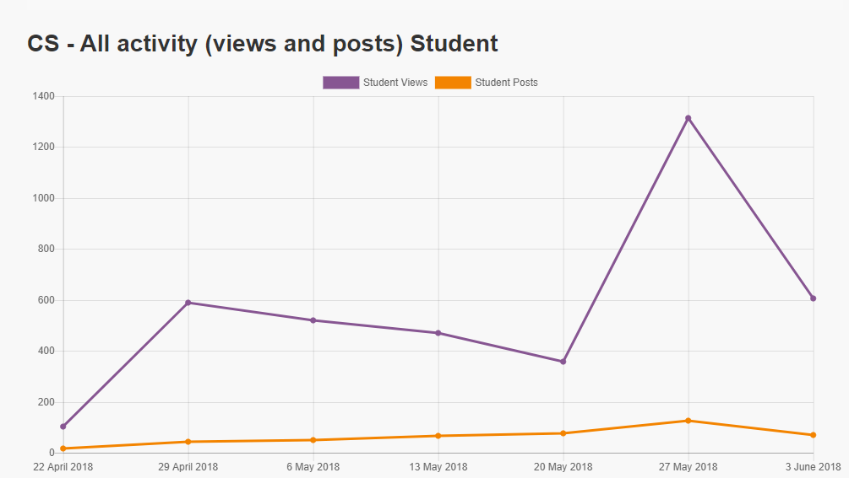
FC course

Slide 7
FC course
Pre-service students´ impressions
Generally positive
Very few objections (spending free time at computers, availability – poorer families, techn)
Suitable for learners from the age of 9 -10
Elementary education – topics concerning “Human beings and their world“
FC always with the ICT support
The most difficult – making a video of a good quality

Slide 8
FC course – students´ opinions
Difficult tasks:
”To motivate students to watch videos at home before the classes and to think about the presented issues.”
„”Not to go back to the traditional front teaching if the FC is not working.”
”To produce and/or find suitable and motivating materials to watch or study before classes.”

Slide 9
FC course – students´ opinions
Comments worth mentioning:
”The FC can motivate students to skip school. – Why to go to school if you have to learn everything at home by yourself?”
”The FC is great – if students cannot go to school, they can still keep up with their classmates.”
”Finally, teachers could spend more time on practical implications (not just explanations) at school.”

Slide 10
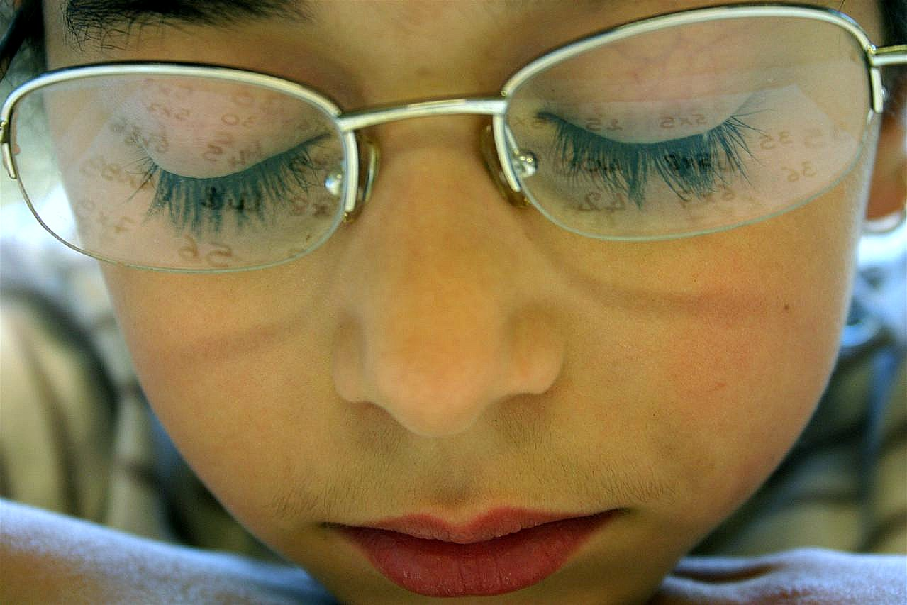
Thank you for your attention.

